Slide 1
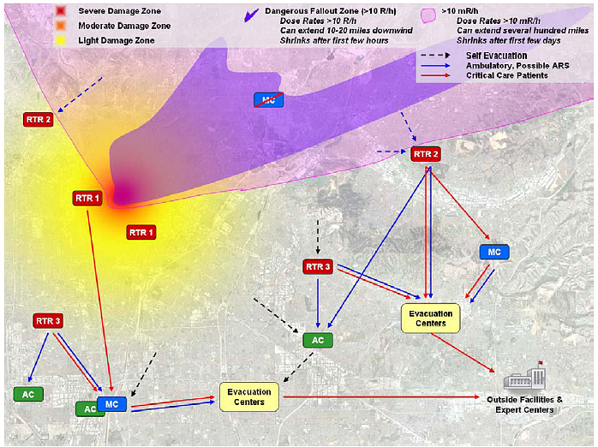
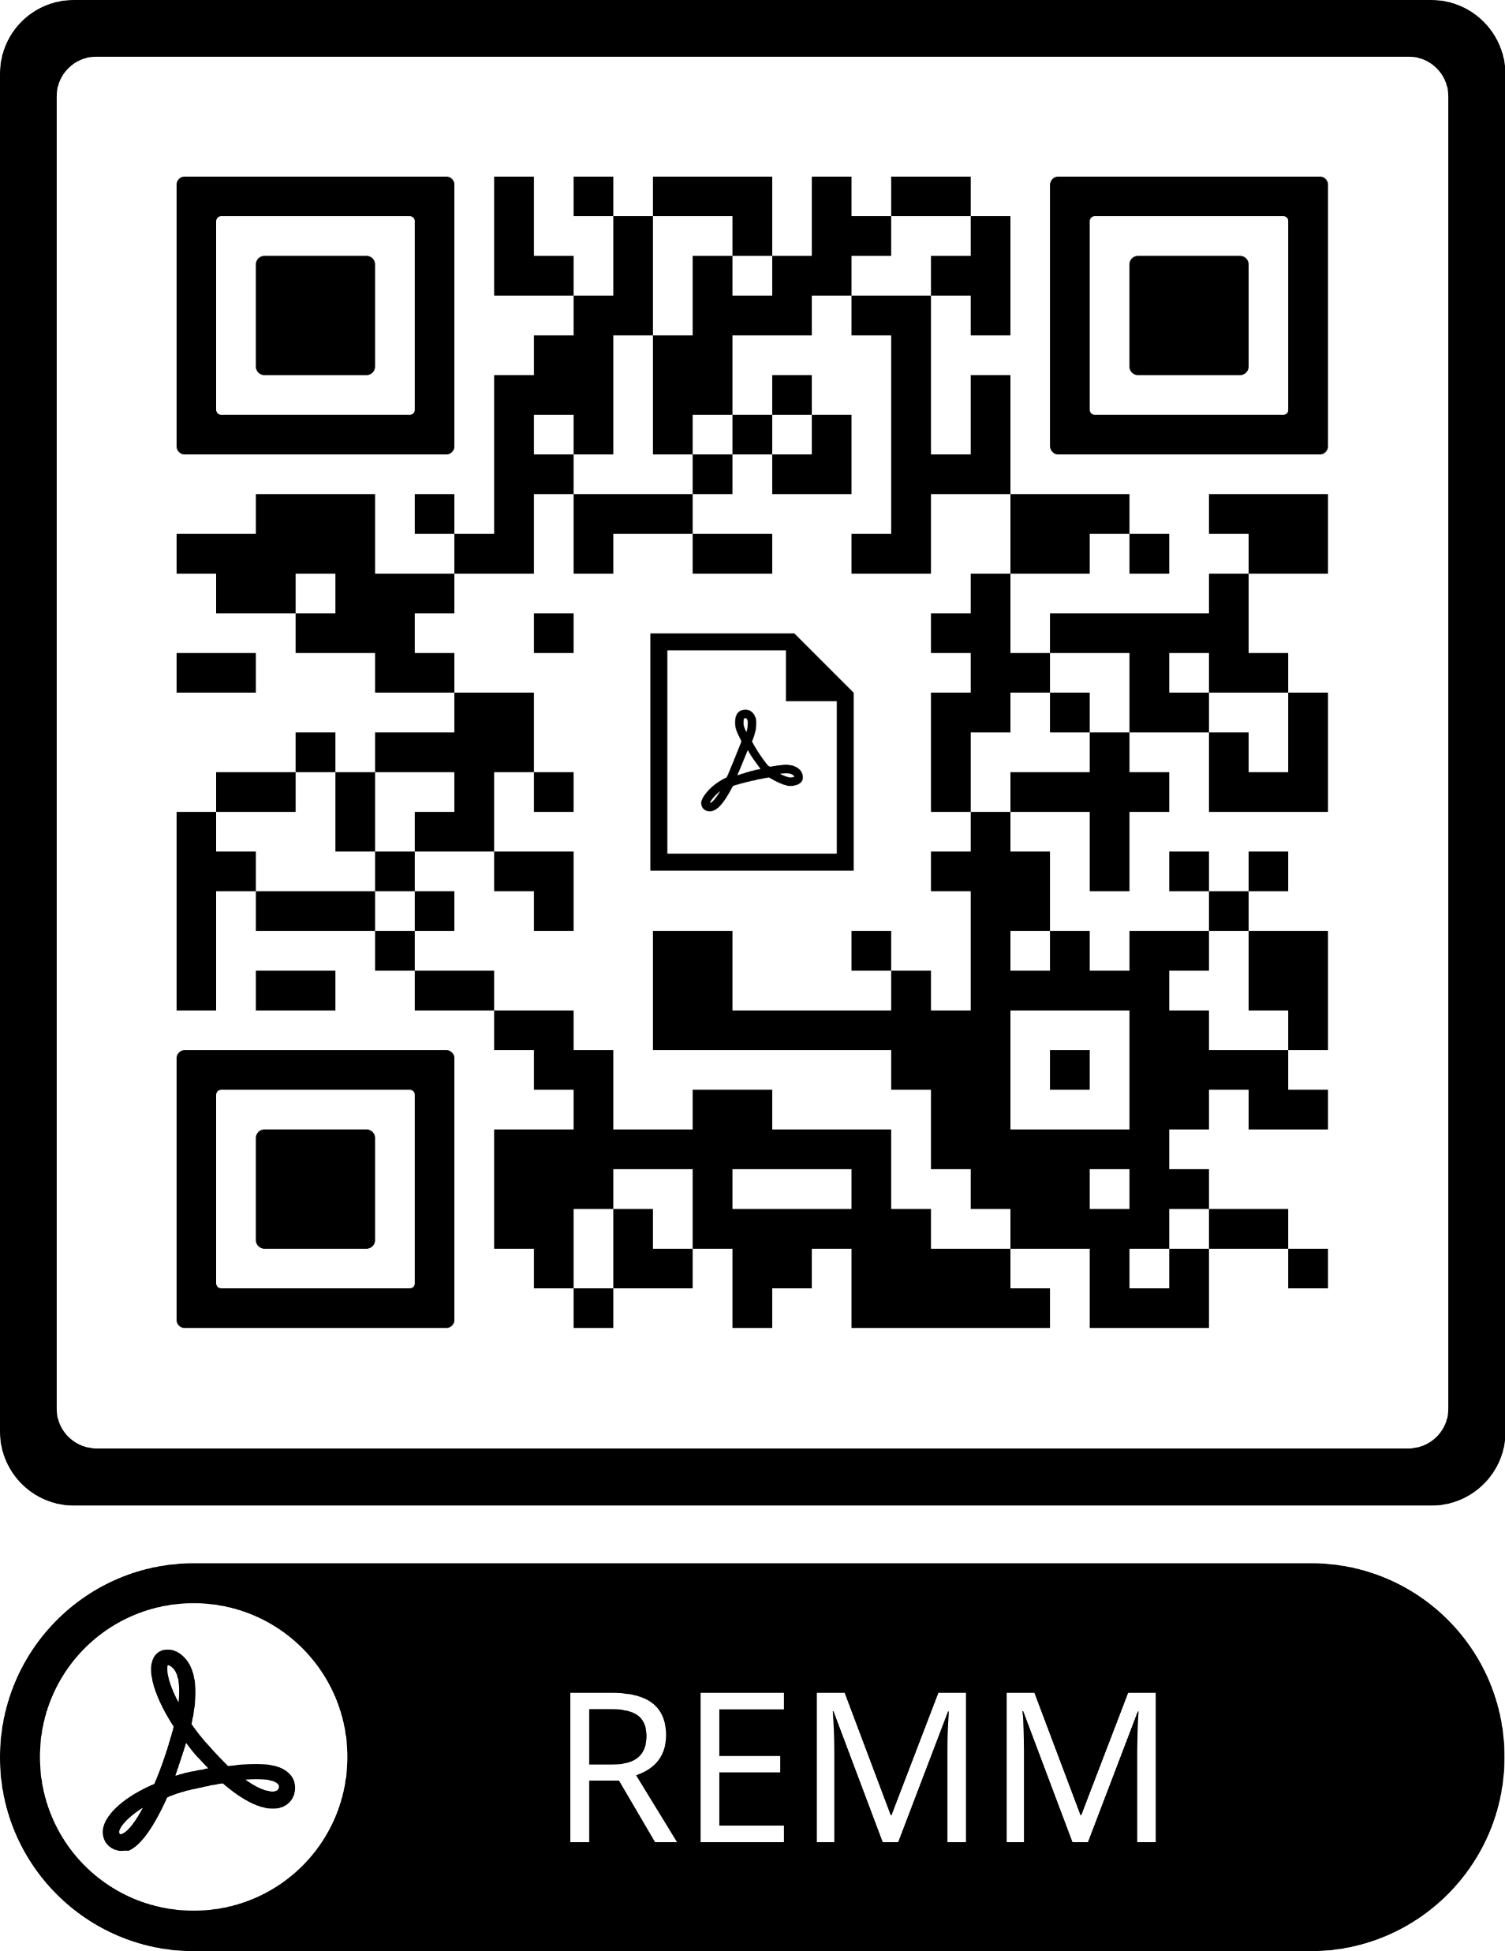
Radiation Event Medical Management
RG Jones MD, MedGlobal-Ukraine
Tim Conley HO, IDMC
Florian Schmitzberger MD, GRM
Peter Akpunonu MD, IDMC

Slide 2
Outline
Types of Threats
Types of Radiation
Risk Reduction
PPE
Management
Resources
Questions
ALL SLIDES AND CHARTS WILL BE PERMANENTLY ARCHIVED AND ACCESSIBLE THROUGH A DEDICATED QR CODE LINK TO PDF VERSION OF THESE SLIDES.

Slide 3
Types of Threats
Nuclear Weapons
Fissile/fusion weapons
High yield weapons (up to 100+ kt); short/intermediate range missiles
Attributes: massive infrastructure damage, mass casualties, and extensive contamination area
Improvised Nuclear Devices
Smaller, lower yield nuclear weapons
Perhaps as small as a backpack; Yields between 5-15 kt
Attributes: significant infrastructure damage, significant blast/burn/trauma, and significant contamination area
Notes:
Modern nuclear weapons have payloads equivalent to 100 or more kiloton explosive power; for reference, WW2 weapons used in Japan were 15-25 kiloton.
Short/intermediate range missiles were previously banned under the INF Treaty, but was withdrawn in 2019 due to non-compliance by Russia and a growing stockpile by China.

Slide 4
Types of Threats
Radiological Dispersal Devices (RDD)- “Dirty Bomb”
Radiologic material combined with a conventional explosive device
Not a nuclear detonation, but nuclear material dispersed by conventional explosion
Concern for use in the context of terrorism
Attributes: limited radiologic contamination, much less radioactive injury; primarily considered a psychological warfare device, area denial weapon
Nuclear Accident
Chernobyl, Fukushima, Three Mile Island
Notes:
Modern nuclear weapons have payloads equivalent to 100 or more kiloton explosive power; for reference, WW2 weapons used in Japan were 15-25 kiloton.
Short/intermediate range missiles were previously banned under the INF Treaty, but was withdrawn in 2019 due to non-compliance by Russia and a growing stockpile by China.

Slide 5
Types of Radiation
α- Alpha
Particle, thus can contaminate the environment
PPE: Stopped by sheet of paper or clothing
Mode of contamination: inhalation, ingestion
β- Beta
Particle, thus can contaminate the environment
PPE: Stopped by thick clothing or foil
Mode of contamination: inhalation, ingestion, skin contact (avoid rain)
γ- Gamma
Non-particle Electro-Magnetic Nature, thus does not contaminate the environment
PPE: Will penetrate up to a few feet of concrete- goes through victims
Mode of contamination: causes exposure but not contamination

Slide 6
Types of Radiation
Particles penetrate differently
α-Particles may be stopped by a single sheet of paper
or a few cell layers of skin
Β-Particles may penetrate more deeply into the body
γ-Particles penetrate through with high energy
Many other types of radiation discussed,
However all essentially behave as α- β- γ-

Slide 7
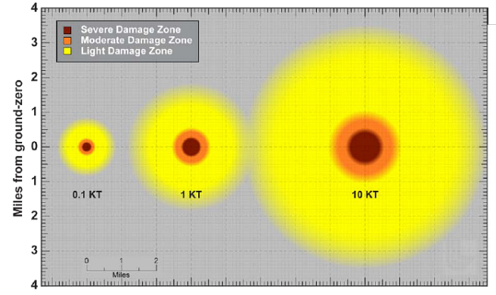
Blast Radius
Notes:
https://remm.hhs.gov/zones_nucleardetonation.htm
Light Damage (LD) Zone:
Damage is caused by shocks, similar to those produced by a thunderclap or a sonic boom, but with much more force. Although some windows may be broken over 10 miles (16 km) away, the injury associated with flying glass will generally occur at overpressures above 0.5 psi. This damage may correspond to a distance of about 3 miles (4.8 km) from ground zero for a 10 KT nuclear explosion. The damage in this area will be highly variable as shock waves rebound multiple times off of buildings, the terrain, and even the atmosphere.
As a responder moves inward, windows and doors will be blown in and gutters, window shutters, roofs, and lightly constructed buildings will have increasing damage. Litter and rubble will increase moving towards ground zero and there will be increasing numbers of stalled and crashed automobiles that will make emergency vehicle passage difficult.
Blast overpressures that characterize the LD zone are calculated to be about 0.5 psi at the outer boundary and 2-3 psi at the inner boundary. More significant structural damage to buildings will indicate entry into the moderate damage zone.
Moderate Damage (MD) Zone:
Responders may expect they are transitioning into the MD zone when building damage becomes substantial. This damage may correspond to a distance of about one mile (1.6 km) from ground zero for a 10 KT nuclear explosion. The determination is made by ground-level and/or overhead imagery.
Observations in the MD zone include significant structural damage, blown out building interiors, blown down utility lines, overturned automobiles, caved roofs, some collapsed buildings, and fires. Some telephone poles and street light poles will be blown over. In the MD zone, sturdier buildings (e.g., reinforced concrete) will remain standing, lighter commercial and multi-unit residential buildings may be fallen or structurally unstable, and many wood frame houses will be destroyed.
Substantial rubble and crashed and overturned vehicles in streets are expected, making evacuation and passage of rescue vehicles difficult or impossible without street clearing. Moving towards ground zero in the MD zone, rubble will completely block streets and require heavy equipment to clear.
Within the MD zone, broken water, gas, electrical, and communication lines are expected and fires will be encountered.
Many casualties in the MD zone will survive, and these survivors, in comparison to survivors in other zones, will benefit most from urgent medical care.
A number of hazards should be expected in the MD zone, including elevated radiation levels, potentially live downed power lines, ruptured gas lines, unstable structures, sharp metal objects and broken glass, ruptured vehicle fuel tanks, and other hazards.
Visibility in much of the MD zone may be limited for an hour or more after the explosion because of dust raised by the shock wave and from collapsed buildings. Smoke from fires will also obscure visibility.
Blast overpressures that characterize the MD zone are an outer boundary of about 2-3 psi and inner boundary of about 5-8 psi. When most buildings are severely damaged or collapsed, responders have encountered the severe damage zone.
Severe Damage (SD) Zone:
Few, if any, buildings are expected to be structurally sound or even standing in the SD zone, and very few people would survive; however, some people protected within stable structures (e.g., subterranean parking garages or subway tunnels) at the time of the explosion may survive the initial blast.
Very high radiation levels from prompt and residual origin and other hazards are expected in the SD zone, significantly increasing risks to survivors and responders. Responders should enter this zone with great caution, only to rescue known survivors.
Rubble in streets is estimated to be impassable in the SD zone making timely response impracticable. Approaching ground zero, all buildings will be rubble and rubble may be 30 feet deep or more.
The SD zone may have a radius on the order of a 0.5 mile (0.8 km) for a 10 KT detonation. Blast overpressure that characterizes the SD zone is 5-8 psi and greater.

Slide 8
Washington, DC: Topol SS-25 (800kt)

Slide 9
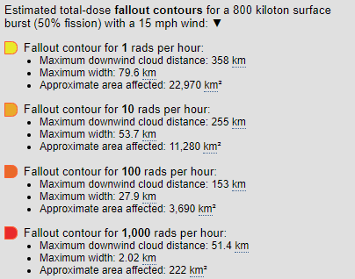
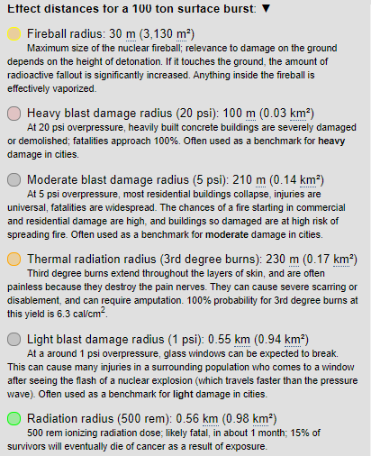
Blast Effects: Topol SS-25 (800kt) vs Crude Bomb

Slide 10
Washington, DC: Topol SS-25 (800kt)

Slide 11
Zaporizhzia, UA: Improvised Devise (10kt)

Slide 12
Zaporizhzia, UA: Improvised Devise (10kt)

Slide 13
Zaporizhzia, UA: Crude terrorist device (100t)
Notes:
Green Radius- Radiation radius (500 rem): 2.96 km (27.5 km²) 500 rem ionizing radiation dose; likely fatal, in about 1 month; 15% of survivors will eventually die of cancer as a result of exposure.

Slide 14
What is “Fallout”?
Pyrocumulus cloud
Ejects fissile and un-fissioned material
as high as 50km into air
1st hour: “Black rain” of radioactive soot
Much may remain in stratosphere for years
and circulate globally
Ground level contamination
Made up of decay materials
U²³⁵ → I¹³¹ + Ba¹⁴⁰ (early: up to 4 months)
→ Ce¹⁴¹ + Zr⁹⁵ + Nb⁹⁵ + Sr⁸⁹ (delayed: up to 2 years)
→ Sr⁹⁰ + Tc⁹⁹ + Cs¹³⁷ + Pb¹⁴⁴ (late: > 2years - 30 years)

Slide 15
Risk Reduction
Decontamination is done to prevent ongoing exposure to radioactive material and prevent exposure to others in close proximity
Poses little risk to responders wearing appropriate PPE.
Respiratory protection and long sleeve clothing are most important PPE
Decontamination zones- outside of hospital, parking lot, etc

Slide 16
REMM- Level C PPE Preferred
Preferred: Level C PPE
Acceptable: Level D PPE plus airway mask
NCB-77 level filtered mask (if available) or N95/Surgical Mask
(does not have to be PAPR or SCBA)
Tyvek/Tychem suit or long sleeve clothing
(does not have to be fancy)
Hair covering and Eye covering
Disposable gloves and shoe covers
In reality, does NOT require substantial PPE thickness or special materials, just cover up skin and avoid breathing dust

Slide 17
REMM- Level D PPE Acceptable
Preferred: Level C PPE
Acceptable: Level D PPE plus airway mask
NCB-77 level filtered mask (if available) or N95/Surgical Mask
(does not have to be PAPR or SCBA)
Tyvek/Tychem suit or long sleeve clothing
(does not have to be fancy)
Hair covering and Eye covering
Disposable gloves and shoe covers
In reality, does NOT require substantial PPE thickness or special materials, just cover up skin and avoid breathing dust

Slide 18
Decontamination
Protect patient’s airway with mask to prevent inhalation of particles
Remove clothing- 80-90% effective
Wipe patient down, focus on hair, exposed skin such as face and arms
Dry wipes, moist wipes
Tape or lint rollers
Use soap and water in limited circumstances
Water used is considered contaminated and requires special disposal
Clean closely around wounds, then cover
Repeat this process until body surface reads <2x background levels
Heavy exposures: sometimes unable to achieve <2x background
Typical background radiation levels: ~20 μSv/hr

Slide 19
Decontamination
Water-deficient environment
Wipe exposed skin with dry wipes, focusing on exposed skin areas
May use tape, lint rollers, sticky gel
Careful not to fix radioactive contaminants to skin when placing bandages
Water-sufficient environment
Use gentle soap and water sparingly, remember that all wastewater is contaminated
When wiping down does not resolve high readings of a body area:
Tape and lint rollers are good option for this, especially in joint areas such as armpits

Slide 20
Decontamination
When wiping down does not resolve high readings of a body area:
Tape and lint rollers are good option for this, especially in joint areas such as armpits
Contamination should not impede or delay the stabilization of a patient:
If the patient becomes unstable during decontamination process, stop decontamination and provide medical intervention

Slide 21
REMM- Management
Trauma and Medical Emergencies take priority over decontamination
Poses little risk to responders wearing appropriate PPE.
Respiratory protection and long sleeve clothing are most important PPE
Decontamination is to remove alpha and beta emitting materials from skin and clothing.
Patients with ingestion may need decorporation (chelation).

Slide 22
REMM- Time to Vomiting
Early and prolonged emesis correlates to radiation dose
Decrease in lymphocyte count correlates with higher dose
Onset of vomiting <4hrs after exposure = high risk of mortality
From REMM.hhs.gov

Slide 23
REMM- Management of Radiation Burns
Behave differently than thermal burns
Delayed in onset by several hours after exposure
Prolonged burn physiology and very slow healing
Typically, any planned surgeries or debridements should be done before onset of acute radiation syndrome symptoms, otherwise treat the same as thermal burns

Slide 24
REMM- Acute Radiation Syndrome (ARS)

Slide 25
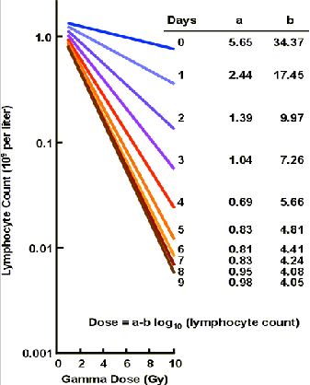
REMM- Management of ARS Subgroups
Hematopoetic- monitor for marrow failure, leukopenia
Transfuse with only leuko-reduced, irradiated blood products, if needed
Lymphopenia correlates to higher dose exposure
Or may use interactive calculator at:
https://remm.hhs.gov/aboutlymphocytedepletion.htm

Slide 26
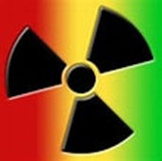
Guskova’s Method for Gamma Dose Estimation
Gy Dose = [a – b] x [log₁₀ Lymphocyte Count]
Where Gy is gamma dose equivalents
Where a and b are coefficients
Where Lymphocyte count is total lymphocytes (units of 10⁹ cells/Liter)
OR
Guskova’s Nomogram
Where days since exposure intersect with observed lymphocytes
OR
Alternative: interactive calculator on REMM App or at:
https://remm.hhs.gov/aboutlymphocytedepletion.htm

Slide 27
REMM- Management of ARS Subgroups
Gastrointestinal
Seen in first 1-2 days, results from destruction of intestinal villi + radiation colitis
Resultant fluid and electrolyte imbalances requiring careful management
Enteral feeds tend to be very poorly tolerated
Tx: ondansetron, benzodiazepines, IV Fluids and IV Electolytes, TPN, loperamide
Neurologic
Typically only observed in very high doses

Slide 28
REMM- Internal Contamination Management
Medical Management of Internal Contamination
For use with moderate to high levels of intake, many countermeasures have unfavorable risk/benefit ratio for low level contamination
Countermeasures are radionuclide dependent, ideally guided by a medical physicist or nuclear medicine physician
Contamination is estimated by units of Annual Limit of Intake (ALI)
Medical countermeasures are discouraged if less than 1 ALI
Medical countermeasures are strongly encouraged if greater than 10 ALIs
Medical countermeasures are case based judgement for conamination >1 and <10 ALIs

Slide 29
REMM- Internal Contamination Management

Slide 30
REMM Response

Slide 31
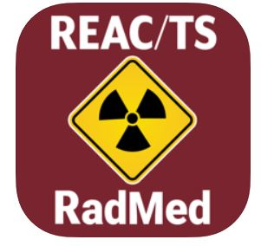
Resources
REMM App
REAC/TS RadMed App
https://nuclearweaponsedproj.mit.edu/
https://remm.hhs.gov/
Check QR code for REMM Medical Management

Slide 32
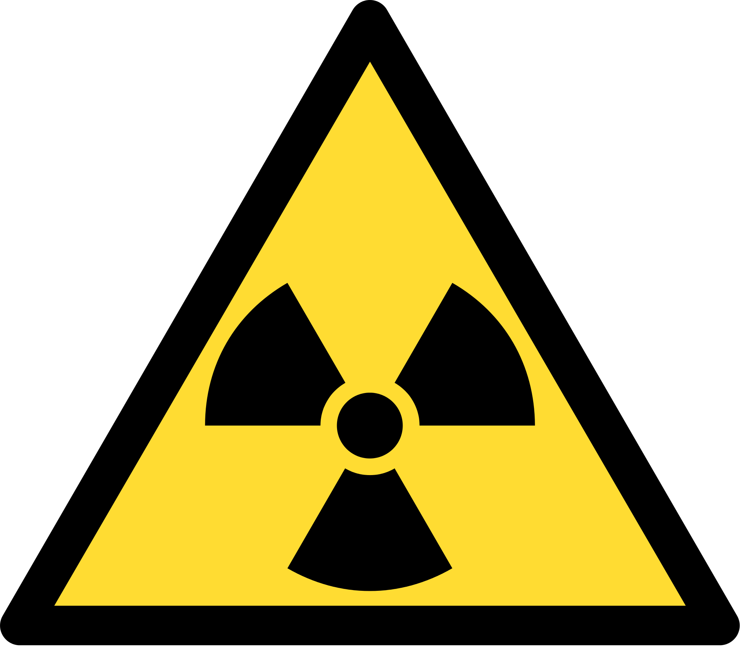
Questions.
MedGlobal.org

