Slide 1

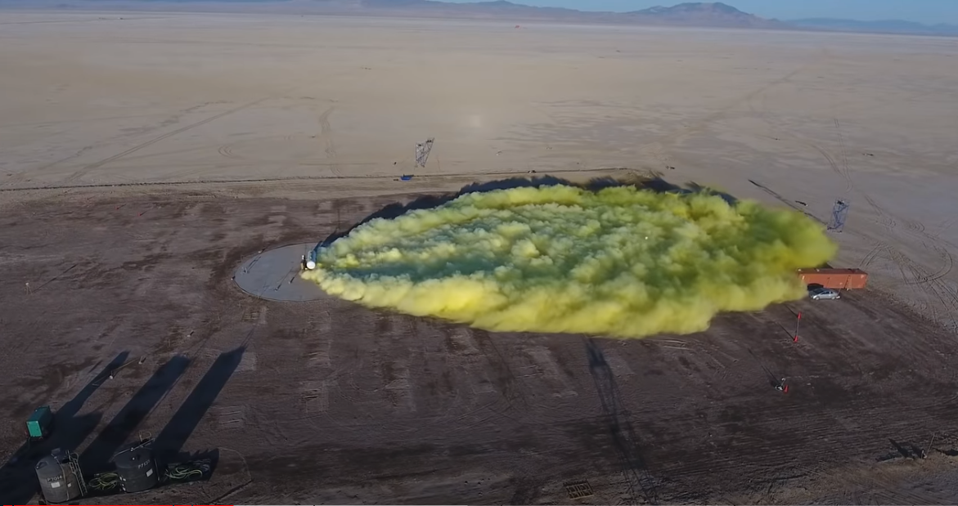


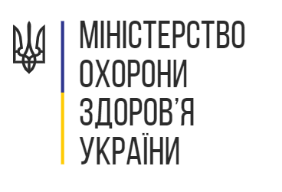



Chemical Weapons
Choking Agents and Toxic Inhalant Injuries
R. G. J. MD MSc MSc DTM&H FACP
Board of Directors- MedGlobal
Assistant Professor of Medicine and Global Health
Notes:
This lecture is delivered in a series prepared on behalf of the Ministry of Health for Ukraine to support medical and humanitarian efforts triggered by the Russian Invasion.
This work is a collaborative effort with the Ukrainian Medical Association of North America (UMANA), Razom for Ukraine, and MedGlobal.
This work is encouraged for redistribution freely and widely with protections reserved under Creative Commons CC BY-NC-SA.
As such, you are encouraged to re-use, distribute, remix, adapt, and build upon the material in any medium or format, so long as it is for noncommercial purposes, and only so long as attribution is given to the creator, Riley Jones. Furthermore, if you remix, adapt, or build upon the material, you must license the modified material under identical terms.
Basically, this presentation is put out here for free, should be shared and used as needed as long as its not for profit, and just give me a small nod of credit if you find it helpful.
My name is Riley Jones and I am your presenter for this series on chemical weapons attacks with nerve agents.
I have worked in various capacities in the humanitarian aid sector for the last decade or so and currently work with MedGlobal who has been tasked with this review of the medical management of nerve agent attacks.
In the spirit of integrity- I have no financial or commercial disclosures to declare.
Now, on with the presentation.

Slide 2
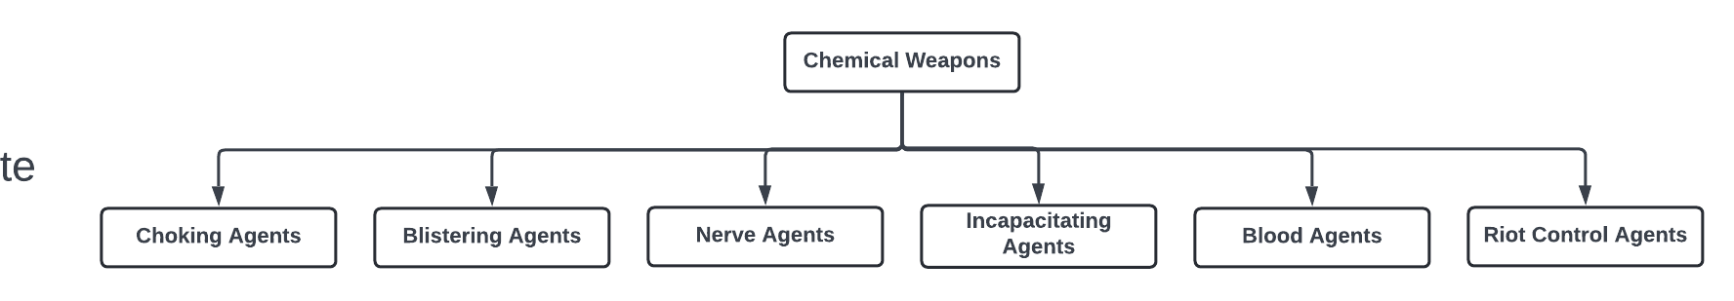

Slide 3
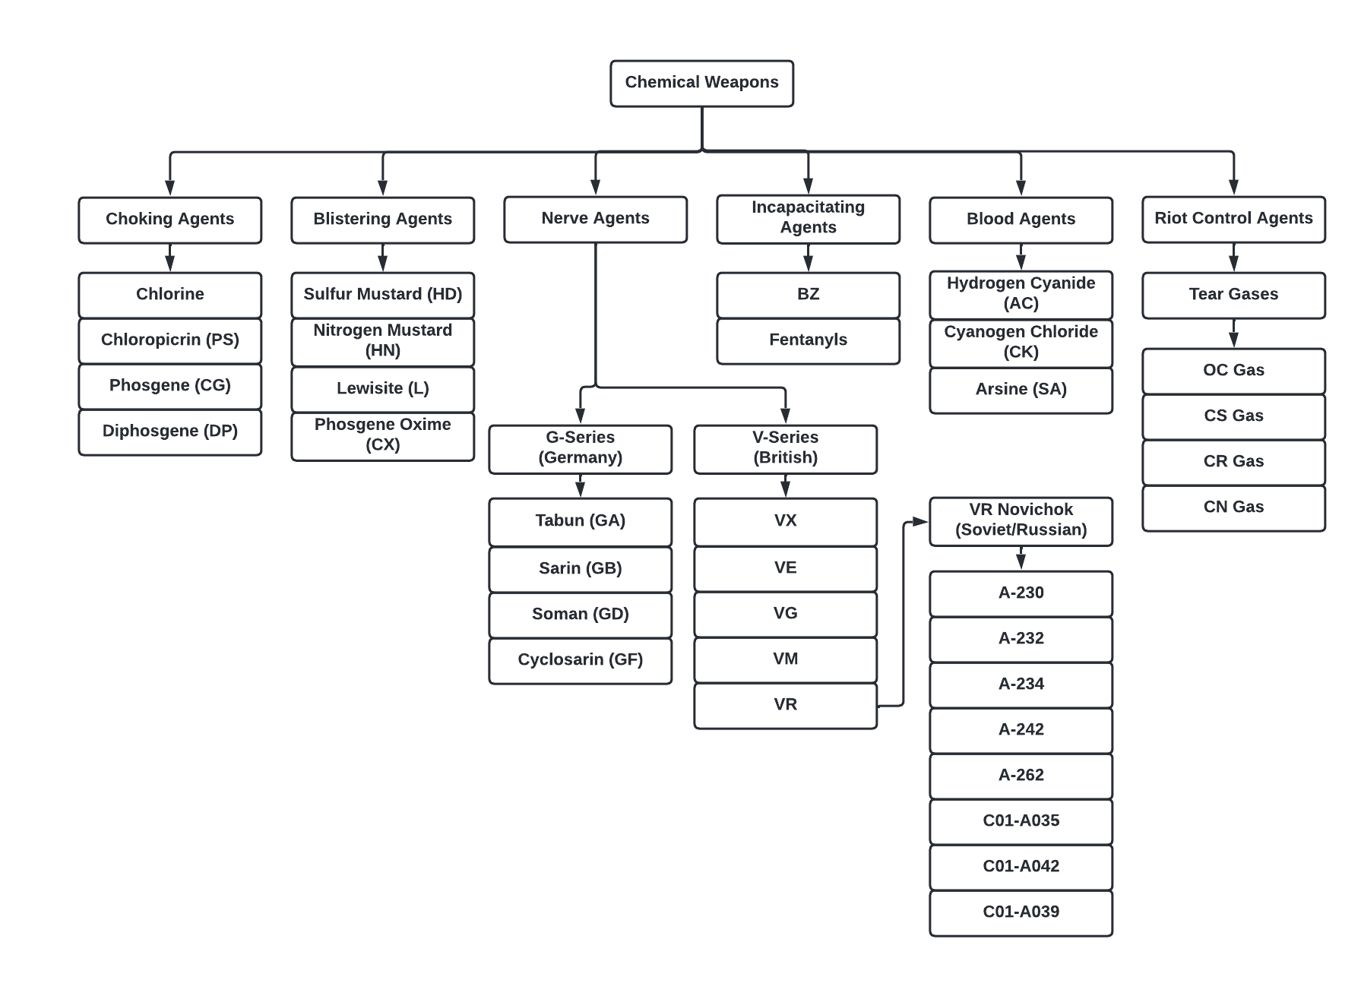
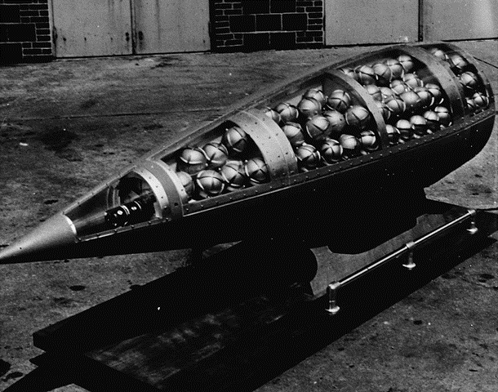
US Honest John missile warhead cutaway, showing M134 Sarin bomblets (c. 1960) Wikipedia.

Slide 4
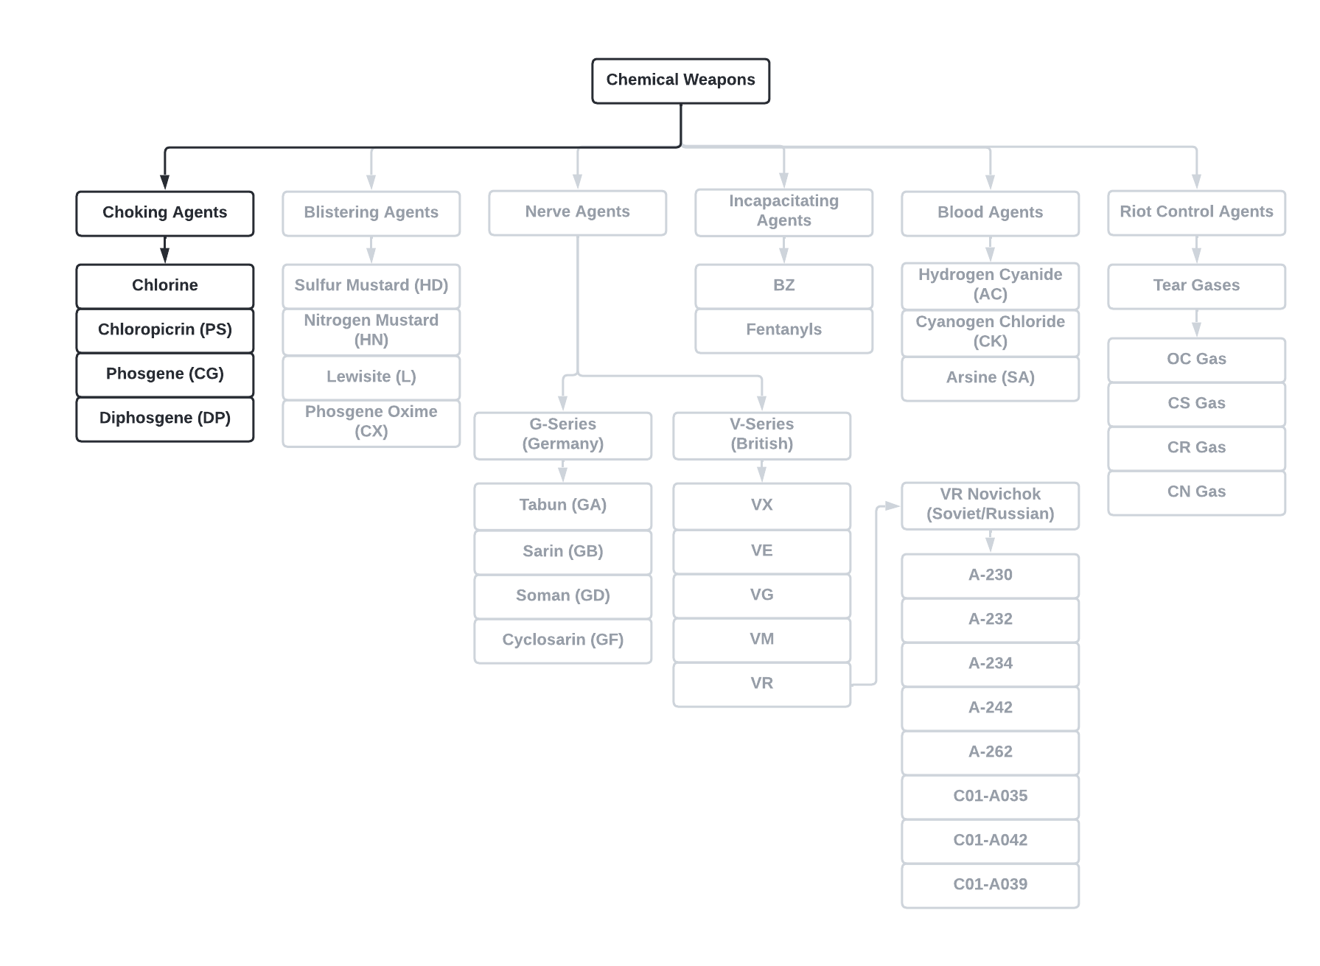
US Honest John missile warhead cutaway, showing M134 Sarin bomblets (c. 1960) Wikipedia.
Notes:
Chlorine gas was first used as a weapon of war at the Second Battle of Ypres in Flanders, Belgium during the First World War on 22 April 1915. This was after the Hague Conventions of 1899 and 1907 wherein chemical warfare was prohibited in the “Declaration concerning the Prohibition of the Use of Projectiles with the Sole Object to Spread Asphyxiating Poisonous Gases” which was ratified during the “Convention respecting the Laws and Customs of War on Land”.
In the first gas attack, German soldiers released 150 tons of chlorine gas down wind resulting in ~5,000 deaths by asphyxiation and delayed lung injury. It gained in popularity and was used repeatedly, eventually being attributed to the deaths of 1.3 million victims by 1918. An international prohibition by major state actors was put into effect by 1925 under the Geneva Protocol by the League of Nations. However, chlorine gas attacks have returned to the battlefield with regularity, notably with the Assad Regime in Syria as well as ISIS insurgency areas in Iraq and Afghanistan.

Slide 5
Outline- Chlorine
Chemical Properties
Clinical Characteristics
Medical Management
Plume Characteristics
Evasion and Loss Prevention
Decontamination and Hospital Preparedness

Slide 6
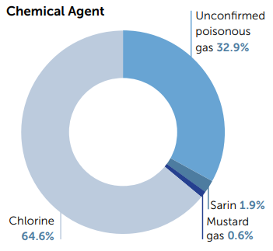
Syrian Experience
Syrian Chemical Weapons Attacks
161 Chemical Attacks (2012-2015)
14,581 Victims
1,491 Deaths
10.2% Mortality Rate
21-August-2013: Rural Damascus
A single sarin attack kills 1,300 and injures over 10,000.
Notes:
Sams 2016.

Slide 7
Choking Agents- Chlorine
Chlorine Mortality
-Civilian Industrial Events: ~0.6%
-Military Events: ~5%
PMID: 29355691
Notes:
Sams 2016.

Slide 8
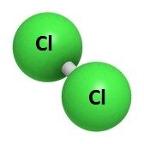
Choking Agents- Chlorine Properties
Yellow-green gas with pungent, irritating odour at 0.31ppm
  Note: olfactory fatigue can occur
Can be made simply: bleach + any household acid (car battery, vinegar, etc)
Boiling point: -34ºC (-29ºF), thus gas at ambient pressure
Heavier than air, thus settles to low lying areas, ditches
Non-flammable gas- vehicle can be driven through cloud
  BUT, explosive when exposed to open fuel fumes

Slide 9
Choking Agents- Chlorine Properties
Moderate water solubility → important clinical implications
Main mechanism of toxicity = oxidation, free radical formation in tissues
  hypochlorous acid + hydrochloric acid formation in airways and eyes
Cl₂ + H₂O → H⁺ClO⁻ + H⁺Cl⁻

Slide 10
Choking Agents- Chlorine Properties
Moderate water solubility → important clinical implications
High Water Solubility
e.g. Ammonia (NH₃), Acrolein (C₃H₄O)
Rapidly cross mucous membranes in upper airways, thus little reaches lower airways
Results in much lower rates of alveolar damage (i.e. less ARDS risk)
Medium Water Solubility
e.g. Chlorine gas (Cl₂)
Crosses mucous membranes in upper airways, but also reaches lower airways
Results in higher rate of alveolar damage (i.e. increased ARDS risk)

Slide 11
Choking Agents- Chlorine
Notes:
So how much does it take to cause damage?
Next slide, we will explore an event to get perspective on PPM

Slide 12
Choking Agents- Chlorine
Notes:
Summary significance, chlorine gas is hazardous at much lower concentrations. If you can see a cloud, it has the potential to be a lethal concentration.
On the next slide, we will explore an event to get perspective on PPM.

Slide 13
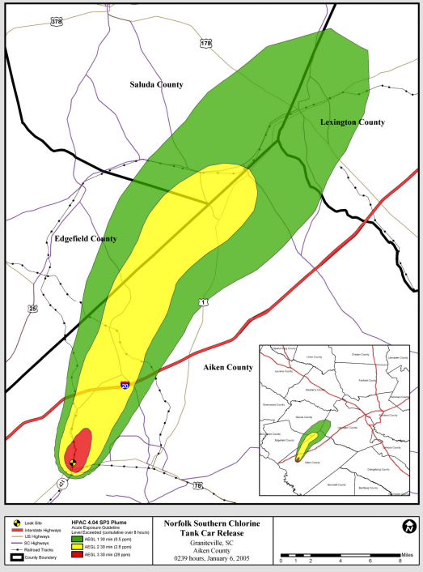
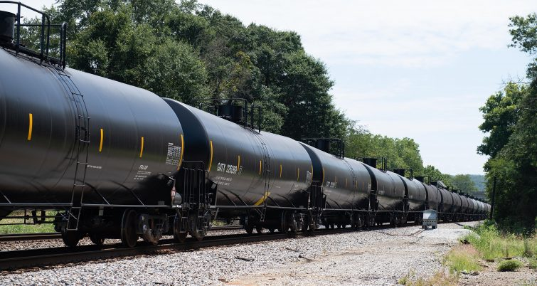
Choking Agents- Chlorine
PMID: 25772143
2005 Graniteville, SC
Notes:
2005 Graniteville, South Carolina, a large industrial event train collision damaged three railroad tankers carrying liquid chlorine
This released the entirety of 55,000Kg of chlorine gas into the area within 3 minutes.
Within 100 meters, there was an estimated 11,642 ppm Chlorine Gas at 60 minutes
At 500 meters, there was 837ppm at 30 minutes and 553 ppm at 60 minutes
At 1000 meters, there was 89ppm at 30 minutes and 51 ppm at 60 minutes
Stated another way, from the epicenter of the accident, the downwind distance to different concentrations is a such:
2,000 ppm was 0.45km at 30 minutes and 0.40km at 60 minutes
400 ppm was 0.69km at 30 minutes and 0.6km at 60 minutes
20 ppm was 2.6km at 30 minutes and also at 60 minutes

Slide 14
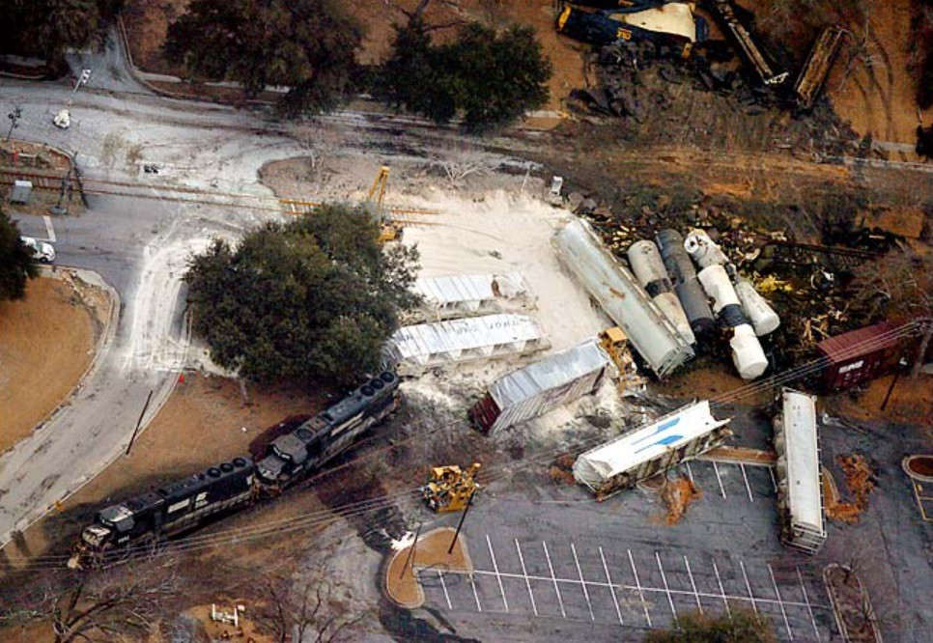
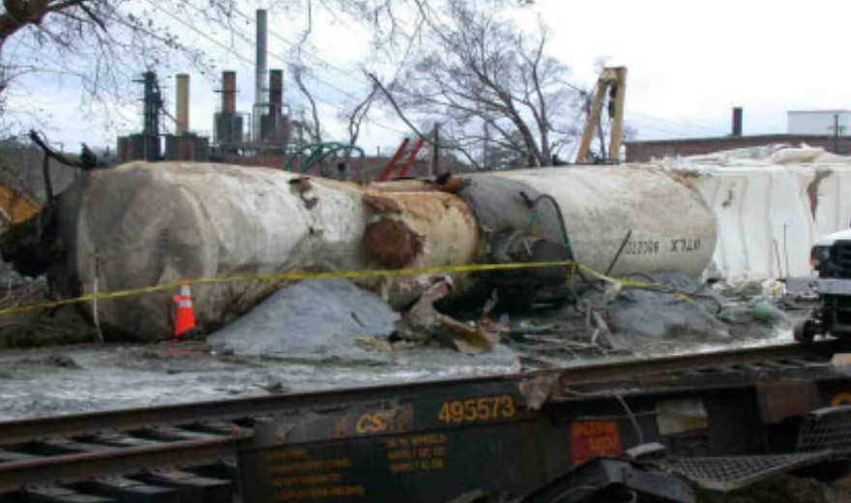
Choking Agents- Chlorine
PMID: 25772143
2005 Graniteville, SC
Notes:
2005 Graniteville, South Carolina, a large industrial event train collision damaged three railroad tankers carrying liquid chlorine
This released the entirety of 55,000Kg of chlorine gas into the area within 3 minutes.
Within 100 meters, there was an estimated 11,642 ppm Chlorine Gas at 60 minutes
At 500 meters, there was 837ppm at 30 minutes and 553 ppm at 60 minutes
At 1000 meters, there was 89ppm at 30 minutes and 51 ppm at 60 minutes
Stated another way, from the epicenter of the accident, the downwind distance to different concentrations is a such:
2,000 ppm was 0.45km at 30 minutes and 0.40km at 60 minutes
400 ppm was 0.69km at 30 minutes and 0.6km at 60 minutes
20 ppm was 2.6km at 30 minutes and also at 60 minutes

Slide 15
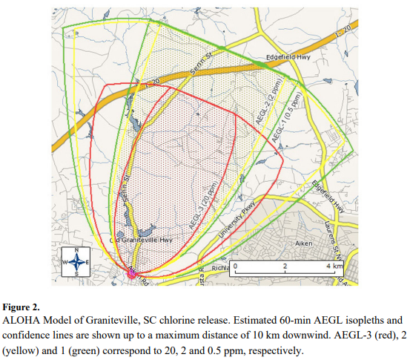
Choking Agents- Chlorine
PMID: 25772143
2005 Graniteville, SC
Notes:
2005 Graniteville, South Carolina, a large industrial event train collision damaged three railroad tankers carrying liquid chlorine
This released the entirety of 55,000Kg of chlorine gas into the area within 3 minutes.
Within 100 meters, there was an estimated 11,642 ppm Chlorine Gas at 60 minutes
Despite this, there were only 9 deaths on the scene, 529 patients presented for emergency services, 311 were seen by outpatient physicians, and 220 developed low grade symptoms for which they did not ultimately seek medical care.

Slide 16
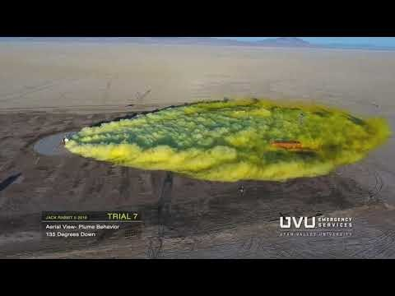
Choking Agents- Chlorine
Wind
Notes:
This is what an industrial event looks like.
Note that the shipping container is about 8.5 Feet tall and the plume falls just below this level.

Slide 17
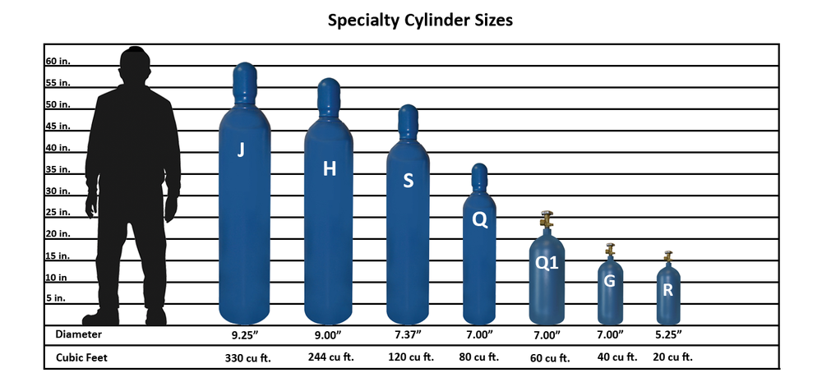
Choking Agents- Chlorine
Notes:
Often, roadside bombs placed during insurgent activities will be more similar to the sizes above

Slide 18

Choking Agents- Chlorine
T= 00:20 max
Notes:
This is what a roadside bomb looks like. This is an example of an ISIS roadside bomb in Iraq. In the current context, chlorine munitions would potentially be a mix of medium sized gas canisters
Allow video to run to a maximum of ~00:20 seconds.

Slide 19
Choking Agents- Chlorine
Clinical Characteristics
Notes:
Now that we have some background on the chemistry and industry involved in Chlorine Gas, lets turn to the clinical manifestations of chlorine attack.
As mentioned, Chlorine gas hydrolyzes on mucous membranes to form hypochlorous and hydrochloric acid.

Slide 20
Chlorine- Clinical Characteristics
Immediate Effects
  Upper Airway
  Lower Airway
  Eyes
  Cardiovascular
  Systemic
  Neurologic
  Psychologic
  Skin
Notes:
Now that we have some background on the chemistry and industry involved in Chlorine Gas, lets turn to the clinical manifestations of chlorine attack.
As mentioned, Chlorine gas hydrolyzes on mucous membranes to form hypochlorous and hydrochloric acid.

Slide 21
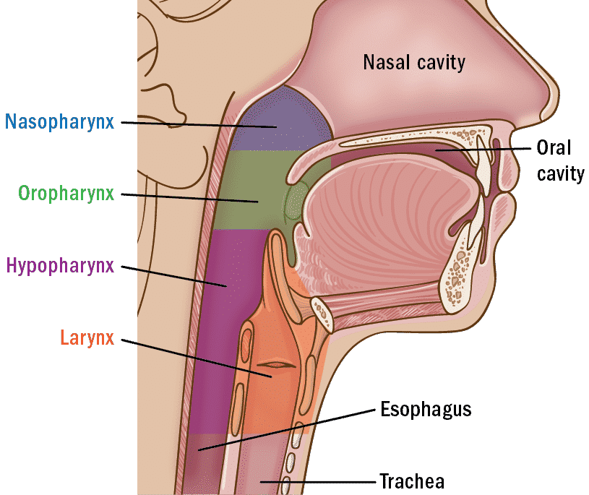
Chlorine Characteristics: Pulmonary
Upper Airway- symptoms present early after the exposure compared to lower airway symptoms
Within Seconds to Minutes:
Burning, tingling of mouth and lips
Sore throat
Superficial redness and inflammation
Laryngospasm, bronchospasm
Notes:
Glottitis

Slide 22
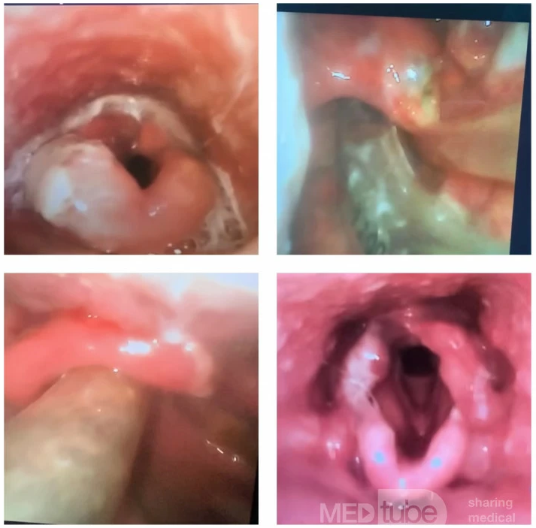
Chlorine Characteristics: Pulmonary
Upper Airway- symptoms present early after the exposure compared to lower airway symptoms
Within 4-12 Hours:
Progressive inflammation and sloughing of oropharyngeal mucosa
Laryngospasm
Stridor = Glottitis = immediate triage
Notes:
Mechanistically: this is essentially acid fume inhalation injury.
Effects on the upper airways may present within a few minutes, such as sore throat, burning sensation in the oropharynx.
With a severe exposure, the upper airways may have progressive inflammation of the mucosa which appears within a few hours (~4 to 12 hours).

Slide 23
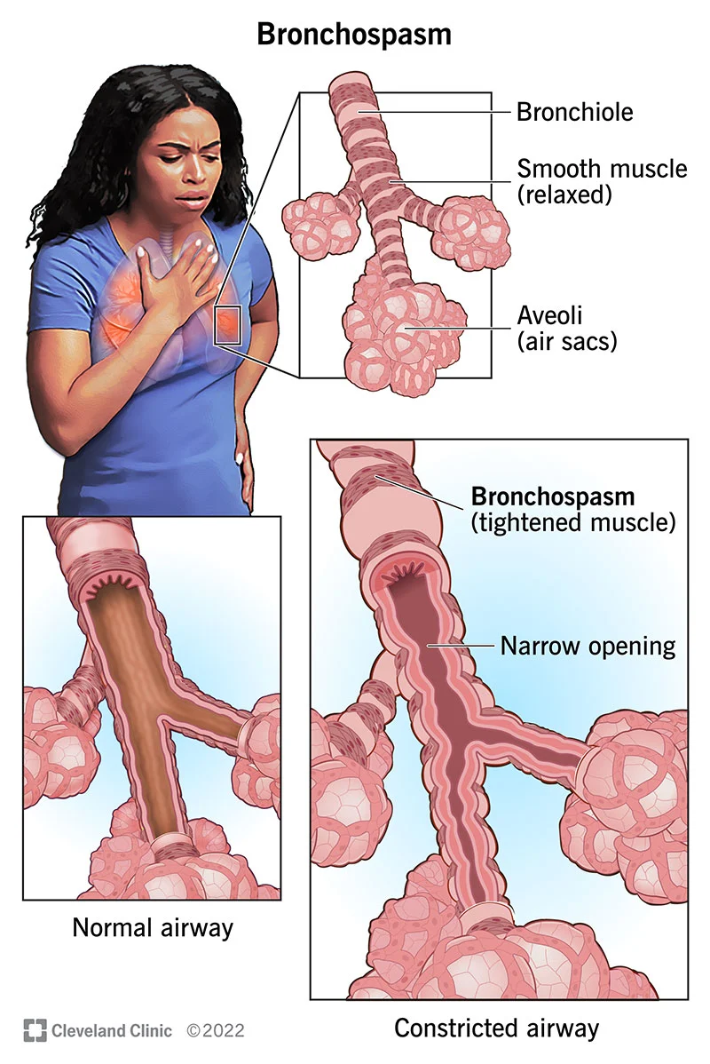
Chlorine Characteristics: Pulmonary
Lower Airway- symptoms manifest after 12-24 hours,
but in severe exposures may present within 0-4 hours.
Bronchospasm
Dry cough
Hemoptysis
Bronchospasm
Toxic Pneumonitis
Pulmonary Edema
ARDS
Notes:
Lower Airway Symptoms frequently present in a delayed fashion

Slide 24
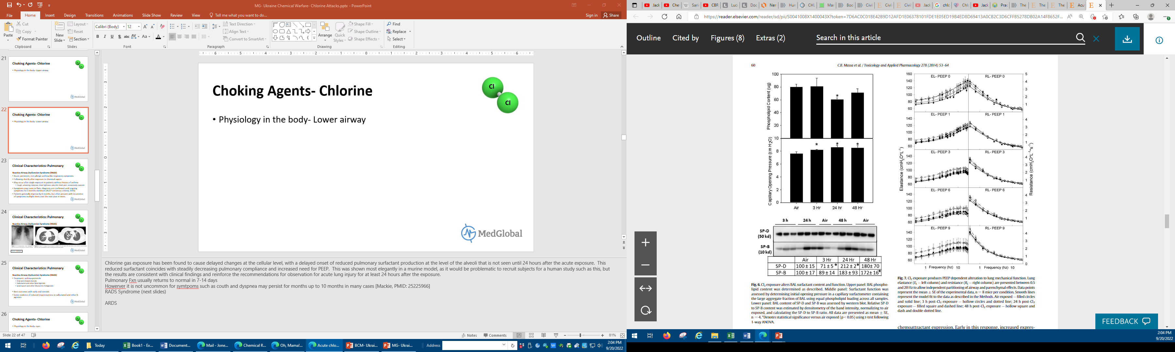
Chlorine Characteristics: Pulmonary
Lower Airway Physiology
Loss of pulmonary surfactant production
~24 hours after gas exposure
= Stiff lungs, difficult ventilation
Manage with standard ARDS protocols-
  lung protective ventilation
  permissive hypercapnia
PMID: 24582687
Notes:
Chlorine gas exposure has been found to cause delayed changes at the cellular level, with a delayed onset of reduced pulmonary surfactant production at the level of the alveoli that is not seen until 24 hours after the acute exposure. This reduced surfactant coincides with steadily decreasing pulmonary compliance and increased need for PEEP. This was shown most elegantly in a murine model, as it would be problematic to recruit subjects for a human study such as this, but the results are consistent with clinical findings and reinforce the recommendations for observation for acute lung injury for at least 24 hours after the exposure.
Pulmonary Fxn usually returns to normal in 7-14 days
Howerver it is not uncommon for symtpoms such as couth and dyspnea may persist for months up to 10 months in many cases [Mackie, PMID: 25225966]
RADS Syndrome (next slides)
ARDS

Slide 25
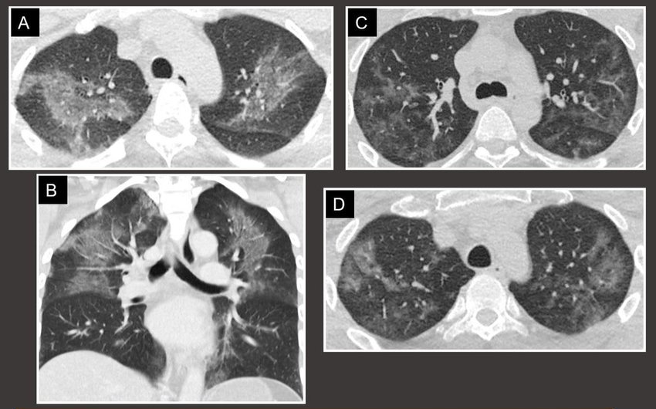
Chlorine Characteristics: Pulmonary
Lower Airway- symptoms manifest after 12-24-48 hours,
but in severe exposures may present within 0-4 hours.
Notes:
Chlorine gas exposure has been found to cause delayed changes at the cellular level, with a delayed onset of reduced pulmonary surfactant production at the level of the alveoli that is not seen until 24 hours after the acute exposure. This reduced surfactant coincides with steadily decreasing pulmonary compliance and increased need for PEEP. This was shown most elegantly in a murine model, as it would be problematic to recruit subjects for a human study such as this, but the results are consistent with clinical findings and reinforce the recommendations for observation for acute lung injury for at least 24 hours after the exposure.
Pulmonary Fxn usually returns to normal in 7-14 days
Howerver it is not uncommon for symtpoms such as couth and dyspnea may persist for months up to 10 months in many cases [Mackie, PMID: 25225966]
RADS Syndrome (next slides)
ARDS
Buroviene, Vytaute & Radikė, Monika & Zaveckiene, Jurgita. (2018). Hold your breath! Inhalational lung disease - imaging findings. ESTI ESCR Congress 2018.

Slide 26
Chlorine Characteristics: Pulmonary
Does a secondary pneumonia occur with toxic inhalation injuries?
  Chest Radiographs: Diffuse infiltrates and pulmonary edema
  Leukocytosis: possibly reactive after acute physiologic stress
  Dyspnea/tachypnea/tachycardia
Literature Review: some reports of prophylactic antibiotics due to the use of steroids.
However, very little evidence of developing true secondary bacterial pneumonia.
Syrian experience: incidence of secondary bacterial pneumonia is LOW
Caution: this is unpublished data and represents consensus of clinical opinion.
Recommend against prophylactic antibiotics unless strong suspicion of true bacterial pneumonia
Notes:
Lower Airway Symptoms frequently present in a delayed fashion

Slide 27
Chlorine Characteristics: Cardiovascular
Retrosternal Chest Pain
Tachycardia
Hypertension (initially)
Hypotension (late, severe exposures)
  Cardiogenic Shock, Nitric Oxide Synthase
Strong suggestion of acute dilated cardiomyopathy
  Multiple autopsy case series and murine studies
  Cardiogenic Pulmonary Edema vs Expansive Non-Cardiac Pulmonary Edema in ARDS?
No specific reports of arrhythmias- sinus tachycardia
PMID: 19041527 ; 26109193
Notes:
Retrosternal chest pain
Tachycardia
Hypertension (initially)
Hypotension and distributive (vasoplegic) shock 2/2 lack of oxygen
Cardiogenic vs non-cardiogenic pulmonary edema: even though cardiomegaly is seen in chlorine exposures, the prevailing evidence for etiology of pulmonary edema is Non-Cardiac in nature.
Sinus Tachycardia- page 4, www.atsdr.cdc.gov.mhmi/mmg172.pdf

Slide 28
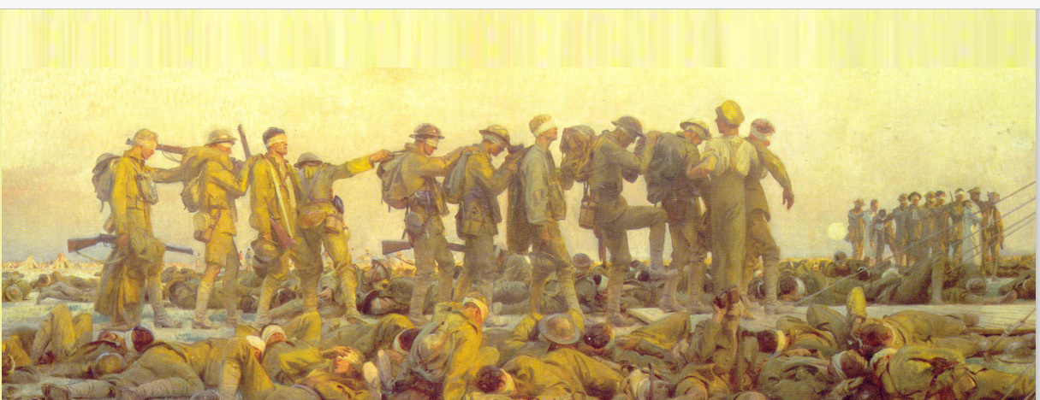
Chlorine Characteristics: Eyes
Conjunctivitis is common (12%): eye pain, redness
Involuntary tearing or spasmodic blinking → do not confuse with seizure
Corneal abrasion, ulceration, (temporary) blindness at high concentrations
Treatment: copious eye irrigation with saline, tap water
followed by supportive care, preservative-free eye drops
Notes:
Eye discomfort, redness, conjunctivitis, tearing → Involuntary spasmodic blinking → Ocular and Corneal chemical burns may occur, but usually not until higher concentrations.
Conjunctivitis is a common feature in ~12% of patients, who will not go on to develop corneal ulcerations

Slide 29
Chlorine Characteristics: Skin
There is no appreciable systemic absorption through the skin.
Sweat on skin can cause formation of acid, thus copious irrigation is needed
Rare cases, blister formation (limited)
Liquid Chlorine can cause localized frostbite
  Remember, Frostbite:
    Without Hypothermia: submerge in warm water
    With Hypothermia: central heat restoration, do not warm the extremity
Notes:
Rarely, excessive chlorine gas exposure may cause hyperchloremia of the blood. This is rare, but may be indicative of large exposures. Hyperchloremia should be managed with standard metabolic acidosis protocols if serum bicarbonate is decreased, such as with sodium bicarbonate supplementation.
Skin- moisture on skin can lead to chemical burns, inflammation, and blistering from chlorine hydrolysis on exposed skin.
Nerves- high doses possible to have significant neurotoxicity with symptoms such as ataxia, tremors, convulsions.

Slide 30
Chlorine Characteristics: Systemic Effects
Gastrointestinal: Nausea, Vomiting
Neurologic: Headache, Ataxia, Tremors, Seizures
Notes:
Rarely, excessive chlorine gas exposure may cause hyperchloremia of the blood. This is rare, but may be indicative of large exposures. Hyperchloremia should be managed with standard metabolic acidosis protocols if serum bicarbonate is decreased, such as with sodium bicarbonate supplementation.
Skin- moisture on skin can lead to chemical burns, inflammation, and blistering from chlorine hydrolysis on exposed skin.
Nerves- high doses possible to have significant neurotoxicity with symptoms such as ataxia, tremors, convulsions.

Slide 31
Chlorine Treatments
Removal and Decontamination
Copious water irrigation
Warming and cleansing of frostbite areas
  20-30 minutes of water bath at 40-42ºC
Overall, treatment is supportive care only.

Slide 32
Chlorine Treatments: Pulmonary
Removal and Decontamination
Humidified Oxygen
Salbutamol
Nebulized Sodium Bicarbonate
  4mL of 4.2% bicarbonate
Nebulized Steroids- Budesonide
Pediatrics: Stridor: nebulized racemic epinephrine
  0.05ml/kg of 2.25% Epinephrine in 3mL saline (maximum of 0.5mL per dose)
  administered every 20 minutes, as needed
Notes:
Sevoflourane?
Aid with bronchospasm, but very limited evidence from a few case reports

Slide 33
Chlorine Characteristics: Hospital Duration
Hospital Length of Stay
In general, patients with moderate symptoms should be monitored for 24 hours, due to delayed presentation of lower lung injury
Data from the Graniteville, SC event was notable for:
  Overall median hospital LOS – 4 days (all hospitalizations)
  Average ICU LOS with Severe Symptoms but not requiring ventilator – 3 days
  Average ICU Ventilator days, if needed – 6 days from the time of intubation
Notes:
It is important to have an idea of the expected length of hospitalization for system planning and triage.
In general, patients with moderate symptoms should be monitored for 24 hours, due to delayed presentation of lower lung injury
Data obtained from the Graniteville, SC event was notable for the following themes:
Overall median LOS – 4 days (this includes all hospitalizations, including ICU patients)
Average ICU LOS with Severe Symptoms but not requiring ventilator – 3 days
Average ICU Ventilator days, if needed – 6 days from the time of intubation

Slide 34
Chlorine Characteristics: Hospital Duration
Discharge:
In most cases, patients will recover within an hour or less
If lingering mild symptoms (slight burning/raw sensation in nose, throat, eyes, airway) and nothing more than a slight cough → Discharge
Advise no smoking for 3 days, no alcohol for 1 day
If skin or eye irritation, more than a slight cough → Advise Monitoring for
at least 24 hours
Skin and eye irritation should be re-evaluated within 24 hours
Notes:
It is important to have an idea of the expected length of hospitalization for system planning and triage.
In general, patients with moderate symptoms should be monitored for 24 hours, due to delayed presentation of lower lung injury
Data obtained from the Graniteville, SC event was notable for the following themes:
Overall median LOS – 4 days (this includes all hospitalizations, including ICU patients)
Average ICU LOS with Severe Symptoms but not requiring ventilator – 3 days
Average ICU Ventilator days, if needed – 6 days from the time of intubation

Slide 35
Chlorine Characteristics: Delayed Effects
Post-Traumatic Stress Disorder and Panic Attacks (~40%)
Chronic Dyspnea and Bronchitis for ~8-10 months, or longer
  Most cases, normal pulmonary function by 7-14 days
Emphysema
RADS- Reactive Airway Dysfunction Syndrome
There are no known cancers or teratogenic effects.
There is no association with fertility impairment.
Notes:
There are many questions about the long term effects that arise from Chlorine exposure:
Known long term effects:
PTSD and Panic Attacks are common in up to 40% of victims- though this data is based off of industrial accident data from Graniteville, SC train wreck. PMID- 22072223
Chronic Dyspnea and Bronchitis may persist for many months, in many cases 8-10 months, and in rare cases permanently (10% at ten years follow-up in WW1 soldiers)
In some cases, patients will develop emphysematous changes to the lung architecture, but this is rare and historically associated with severe exposures
Some of the long term effects that we know are NOT associated with chlorine exposure:
No known association with cancers
No association with reduced fertility
No known teratogenic effects

Slide 36
Chlorine Characteristics: Pulmonary
Reactive Airway Dysfunction Syndrome (RADS)
Acute, persistent, non-allergic asthma-like respiratory symptoms
Following shortly after exposure to chemical vapors
May occur after single exposure in patients without history of asthma
  Cough, wheezing, dyspnea, chest tightness, pleuritic chest pain, occasionally cyanosis
Symptoms may come in flairs, diagnosis not confirmed until ongoing symptoms for 3 months minimum (ACCP consensus criteria, 1995)
Patients generally improve by 6 months, but often present with recurrence of symptoms multiple times over the next year or more.
Notes:
Reactive Airway Dysfunction Syndrome (RADS)- Asthma-like reaction due to chemical irritation.

Slide 37
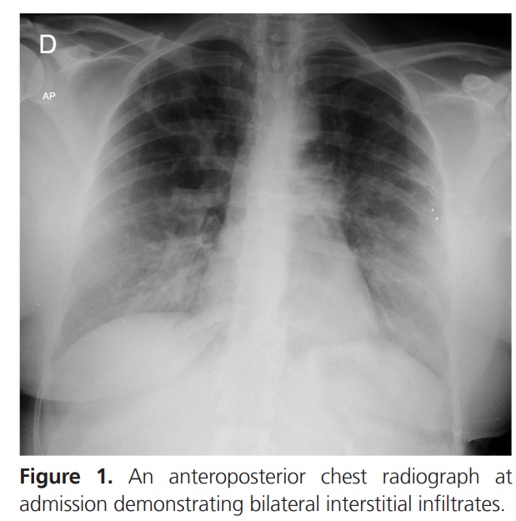
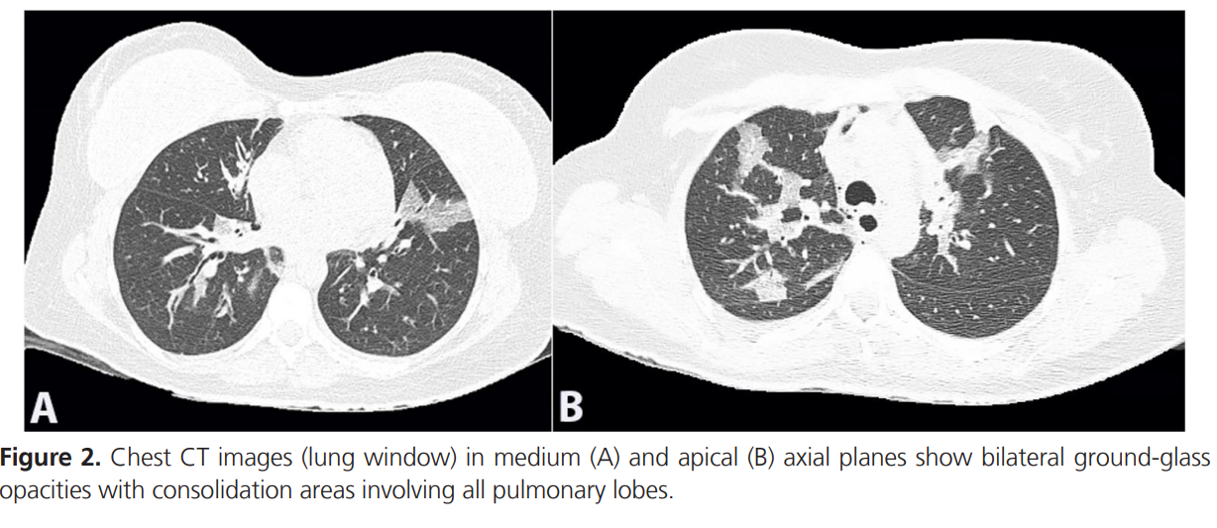
Chlorine Characteristics: Pulmonary
Reactive Airway Dysfunction Syndrome (RADS)
PMID: 33968833
Notes:
Reactive Airway Dysfunction Syndrome (RADS)- Asthma-like reaction due to chemical irritation.

Slide 38
Chlorine Characteristics: Pulmonary
Reactive Airway Dysfunction Syndrome (RADS)
Treatment: asthma-protocols
  Oral and inhaled steroids
  Salbutamol and other Beta Agonists
  Ipratropium and other Muscarinic Antagonists
Best outcomes with early oral steroids
Some evidence of reduced responsiveness to salbutamol and other B-agonists
Notes:
Reactive Airway Dysfunction Syndrome (RADS)- Asthma-like reaction due to chemical irritation.

Slide 39

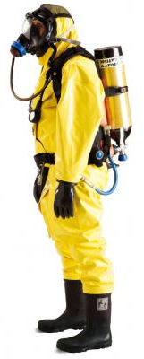
Chlorine Decontamination
Hot Zone
  Positive pressure SCBA suits
    Prevents pulmonary irritation of the rescuer
    Suit prevents chlorine accumulation on the skin which can cause skin irritation
  ABCs of emergency care
  Administer applicable interventions
    Eg: CANA, Atropine
  Focus on victim removal

Slide 40
Chlorine Decontamination
Decontamination Zone
ABCs of Emergency Care
Victims without skin or eye irritation
  Do not need substantial decontamination → Immediate removal to support zones is indicated
  Chlorine liquid should be rinsed or removed to prevent off-gassing and local chemical irritation
  Victims who can cooperate should be instructed to do their own decontamination and self-removal from the area

Slide 41
Chlorine Decontamination
Decontamination Zone
Victims with skin irritation
  3-5 minutes plain water irrigation of skin and hair
  Two washes with mild soap
Victims with eye irritation
  15 minutes plain water or saline irrigation of the eyes
  Remove contact lenses, if can be done without damaging surrounding tissues
Victims with eye frostbite
  Do not irrigate the eyes- increases damage

Slide 42
Chlorine Decontamination
Support Zone
Ensure that victims are properly decontaminated
ABCDE’s of Emergency Care
Transfer to receiving health providers

Slide 43
Chlorine Dispersal Properties
The maximum width of cloud expansion is at 35 seconds.
The gas does not move upwind.
If caught in a chlorine cloud,
  Move Horizontally and Upwind
Images from: Chlorine Institute
Notes:
Information obtained from the Jack Rabbit Trials conducted in 2015-2016 by the US Department of Homeland Security and Chemical Security Analysis Center.

Slide 44
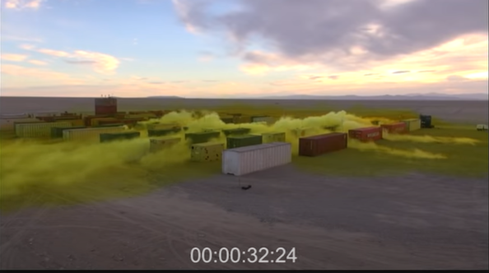
Chlorine Dispersal Properties
Buildings and structures can channel the movement of gas cloud.
Maximum height of gas was ~2.5m high.
Images from: Chlorine Institute
Notes:
Information obtained from the Jack Rabbit Trials conducted in 2015-2016 by the US Department of Homeland Security and Chemical Security Analysis Center.

Slide 45
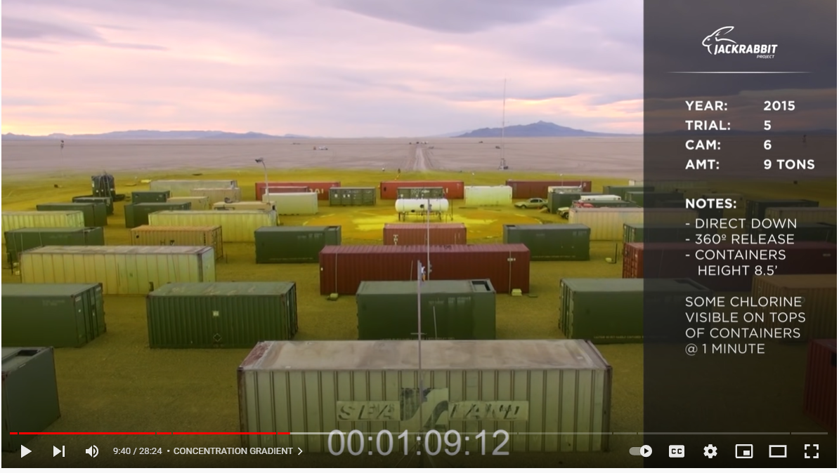
Chlorine Dispersal Properties
Even in a large tanker explosion, the majority of gas has settled to its maximum cloud height above ground by 1 minute. No longer visible by 1:30.
Images from: Chlorine Institute
Notes:
Information obtained from the Jack Rabbit Trials conducted in 2015-2016 by the US Department of Homeland Security and Chemical Security Analysis Center.

Slide 46
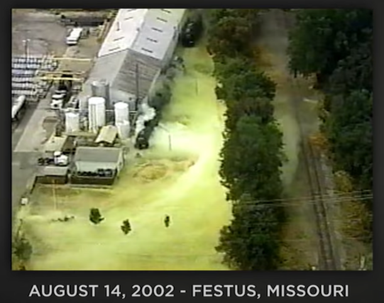
Chlorine Dispersal Properties
The gas does appear to be slowed down and consumed by foliage hedges and organic matter.
Images from: Chlorine Institute
Notes:
Information obtained from the Jack Rabbit Trials conducted in 2015-2016 by the US Department of Homeland Security and Chemical Security Analysis Center.

Slide 47
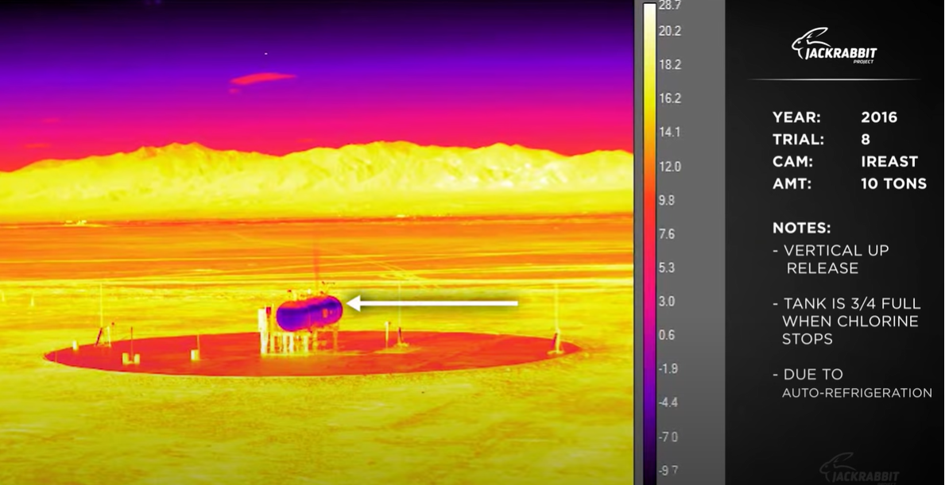
Chlorine Dispersal Properties
Auto-refrigeration can occur at 25% release, where partially released ordinance can remain a threat.
Contact with chlorine during disposal may have increased risk of corrosiveness to responders due to interaction with ambient moisture.
50% of liquid can be absorbed and remain persistent in the top 4-13cm of soil, again corrosive when moist.
Images from: Chlorine Institute
Notes:
Information obtained from the Jack Rabbit Trials conducted in 2015-2016 by the US Department of Homeland Security and Chemical Security Analysis Center.

Slide 48
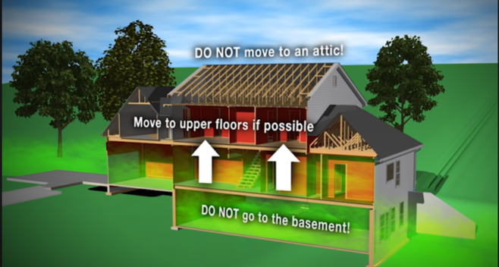
Chlorine Gas: Local Defense
If escape from a gas cloud is not possible, seek high ground
If shelter in place is necessary:
  Shut doors and windows
  Shut off HVAC- Air Vents
  Move to upper floors
  Wait for emergency responders
Images from: Chlorine Institute
Notes:
Do not forget, children are at increased risk not only due to their short stature, but also due to increased pulmonary:body mass ratio as well as relatively higher minute ventilation rate than adults.

Slide 49
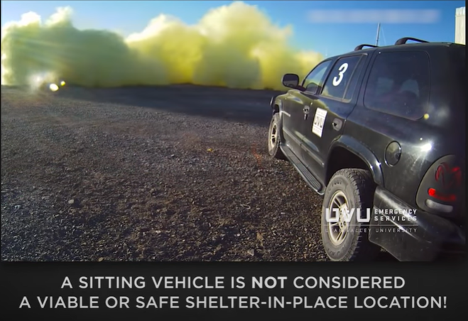
Chlorine Gas: Local Defense
If escape from a gas cloud is not possible, seek high ground
If caught in vehicle:
  Engine will still run (gas & diesel)
  Close Windows and Doors
  Disable Air Conditioners
  Close Air Vents
  Drive to safe location and exit
    Gas can rapidly accumulate in vehicle
Images from: Chlorine Institute
Notes:
Do not forget, children are at increased risk not only due to their short stature, but also due to increased pulmonary: body mass ratio as well as relatively higher minute ventilation rate than adults.

Slide 50
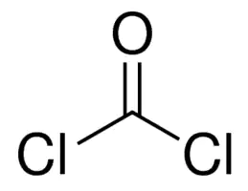
Choking Agents- Phosgene
Pulmonary irritant that causes severe pulmonary edema
Colorless Gas
Boils at 8.2ºC
Smells of “newly mown hay” or “green corn”
  Olfactory detection at 1.5 mg . m³
  Pulmonary irritant at 4.0 mg . m³
  LCt₅₀ 6000 mg . min . m³ (half the LCT₅₀ of Chlorine)
Last known use during Yemeni Civil War, 1963-1967.
Notes:
Overall, it is less potent than the V and G series chemical weapons, it is still very dangerous. Deaths have occurred after only a few breaths of high concentrations of phosgene.

Slide 51
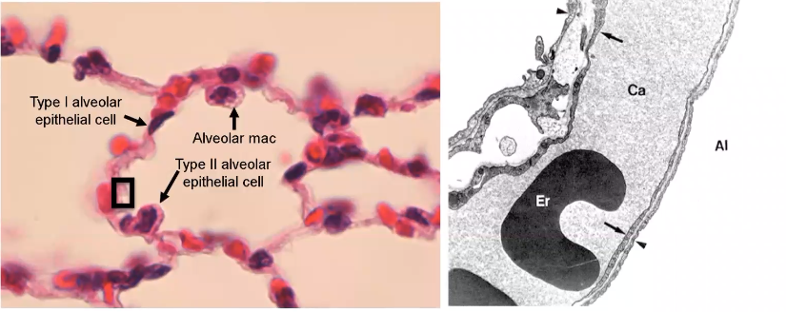
Choking Agents- Phosgene
Phosgene is relatively insoluble, thus tends to reach lower into the airways
Chemical reaction on tissues induces free radical formation leading to wide spread cellular damage.
Notes:
The normal lung has four types of cells:
Type 1 Alveolar epithelial cell: think of as a fried egg- wide and flat with a nucleus bump in the middle, covers 95% of the surface of the alveolus
Type 2 Alveolar epithelial cell: is more cuboidal, it is the manufacturing center producing all sort of proteins and surfactants
Alveolar Macrophage- on average, only one macrophage per alveolus, thus it has much work to do
Pulmonary Capillary endothelial cells which line the capillaries through with RBCs move.
Electron Micrograph of the area in the black box:
Al: alveolus
ER: erythrocyte
Ca: capillary lumen
Arrow: endothelial cell
Arrow Head: type1 alveolar epithelial cell (incredibly small!)
The space between the Arrow and the Arrow Head is the space where gas exchange occurs- this is where much of pulmonary medicine is interested, in protecting the space between the arrows
Slides Adapted from ARDS review by Dr. Borna Mehrad, UF College of Medicine

Slide 52
Choking Agents- Phosgene
Latent onset damage:
No clinical symptoms for 20 minutes → 24 hours
  Development of symptoms < 4 hours of exposure = grim prognosis →ICU Immediately
Fluid and capillary leak → pulmonary edema
  Dyspnea, respiratory distress
  frothy sputum and nares
Pulmonary edema peaks at 12 hours, frequently described as “relentless”
Resolution of edema usually within 48 hours, often with little residual effects

Slide 53
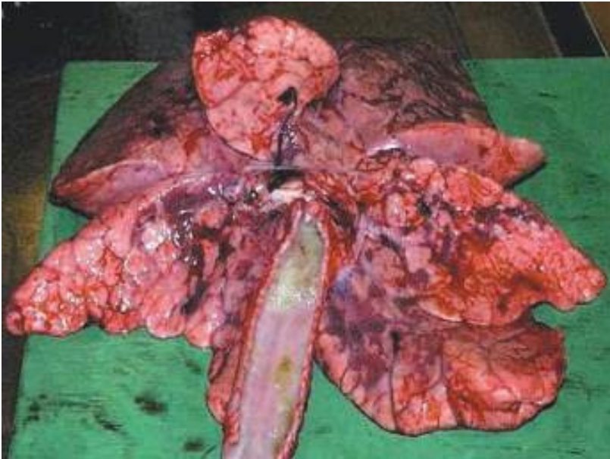
Choking Agents- Phosgene
Pulmonary edema peaks at 12 hours, frequently described as “relentless”
Hyper-inflated, edematous lungs with
multifocal pulmonary hemorrhage
Image from: OPWC, 2016.

Slide 54
Phosgene- Treatments
Removal and decontamination
Enforced Rest
Supplemental Oxygen without Hyper-oxygenation
Early administration of IV steroids
  Methylprednisolone 700-1000mg/day divided every 6-8 hours
Positive Pressure Airway Support
Vasopressors- expect hypotension, this limits safety of diuretics
Salbutamol/ipratropium
  particularly if P_{a}CO₂ >45mmHg, suggesting bronchospasm

Slide 55
Choking Agents- Phosgene Triage
In general, shorter onset of symptoms from event = greater severity of illness
Within 12 hours of exposure:
Asymptomatic but with known exposure → Minimal, but survey every 2 hours for 24 hours, then discharge
Dyspnea without objective edema → Delayed
Evidence of Pulmonary Edema → Category Immediate
Notes:
Triage recommendations from OPCW, 2016. Practical Guide for Medical Management of Chemical Warfare Casualties.
Available at: https://www.opcw.org/sites/default/files/documents/ICA/APB/Practical_Guide_for_Medical_Management_of_Chemical_Warfare_Casualties_-_web.pdf

Slide 56
Choking Agents- Triage
In general, shorter onset of symptoms from event = greater severity of illness
Within 12 hours of exposure:
Evidence of Pulmonary Edema → Immediate
Evidence of Pulmonary Edema + cyanosis + hypotension→ Expectant unless full critical care services immediately available especially if symptoms occur < 4 hours after exposure
Notes:
Triage recommendations from OPCW, 2016. Practical Guide for Medical Management of Chemical Warfare Casualties.
Available at: https://www.opcw.org/sites/default/files/documents/ICA/APB/Practical_Guide_for_Medical_Management_of_Chemical_Warfare_Casualties_-_web.pdf

Slide 57
Choking Agents- Summary
General themes, hospital system preparedness for mass casualty incidents
    Coordination, Communication, Adaptation
    Decontamination, Triage, Treatment
Chlorine- common, low lethality, but psychiatric impacts are significant
Phosgene- historical significance, but no known uses in >50 years

Slide 58
References
  Mackie E, Svendsen E, Grant S, et al. Management of chlorine gas-related injuries from the Graniteville, South Carolina, train derailment. Disaster Med Public Health Prep 2014;8(5):411-6. PMID: 25225966
  Jani DD, Reed D, Feigley CE, et al. Modeling an irritant gas plume for epidemiologic study. Int J Environ Health Res 2016;26(1):58-74. PMID: 235772143
  Faria VS, da Silva SA, Marchini JFM. Reactive airways dysfunction syndrome following inhalation of hydrogen chloride vapor. Autops Case Rep 2021;11:e2021266. PMID: 33968833
  OPCW, 2016. Practical guide for medical management of chemical warfare casualties. Available at: https://www.opcw.org/sites/default/files/documents/ICA/APB/Practical_Guide_for_Medical_Management_of_Chemical_Warfare_Casualties_-_web.pdf [Accessed 20-Sept- 2022]

Slide 59
References
  Massa CB, Scott P, Abramov E, et al. Acute chlorine gas exposure produces transient inflammation and a progressive alteration in surfactant composition with accompanying mechanical dysfunction. Toxicol Appl Pharmacol 2014;278(1):53-64. PMID: 24582687
  Van Sickle D, Wenck MA, Belflower A, et al. Acute health effects after exposure to chlorine gas released after a train derailment. Am J Emerg Med 2009;27(1):1-7. PMID: 19041527
  Zaky A, Bradley WE, Lazrak A, et al. Chlorine inhalation-induced myocardial depression and failure. Physiol Rep 2015;3(6):e12439. PMID: 26109193

Slide 60
Questions

