Slide 1
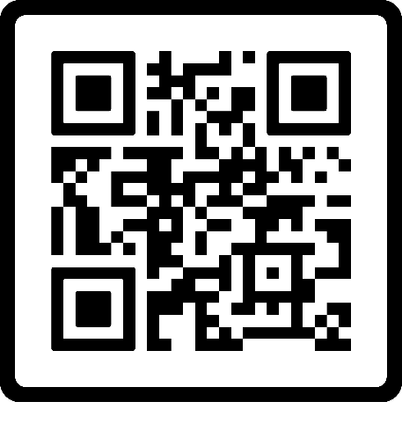

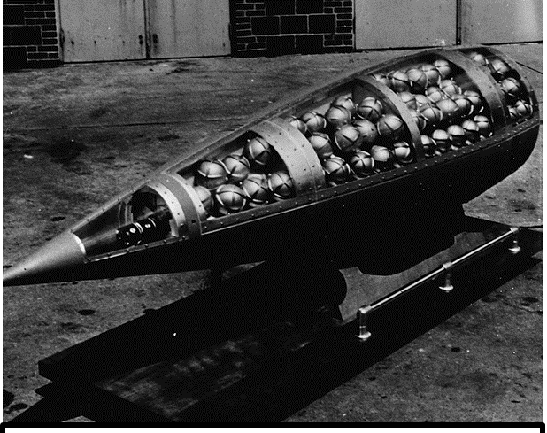


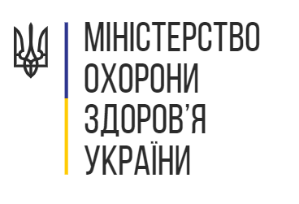



Chemical Weapons
Nerve Agents
R. G. J. MD MSc MSc DTM&H FACP
Board of Directors- MedGlobal
Assistant Professor of Medicine and Global Health
Notes:
This lecture is delivered in a series prepared on behalf of the Ministry of Health for Ukraine to support medical and humanitarian efforts triggered by the Russian Invasion.
This work is a collaborative effort with the Ukrainian Medical Association of North America (UMANA), Razom for Ukraine, and MedGlobal.
This work is encouraged for redistribution freely and widely with protections reserved under Creative Commons CC BY-NC-SA.
As such, you are encouraged to re-use, distribute, remix, adapt, and build upon the material in any medium or format, so long as it is for noncommercial purposes, and only so long as attribution is given to the creator, Riley Jones. Furthermore, if you remix, adapt, or build upon the material, you must license the modified material under identical terms.
Basically, this presentation is put out here for free, should be shared and used as needed as long as its not for profit, and just give me a small nod of credit if you find it helpful.
My name is Riley Jones and I am your presenter for this series on chemical weapons attacks with nerve agents.
I have worked in various capacities in the humanitarian aid sector for the last decade or so and currently work with MedGlobal who has been tasked with this review of the medical management of nerve agent attacks.
In the spirit of integrity- I have no financial or commercial disclosures to declare.
Now, on with the presentation.

Slide 2
Chemical Weapons

Slide 3
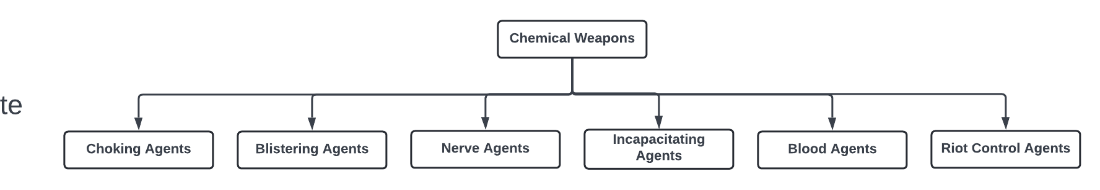

Slide 4
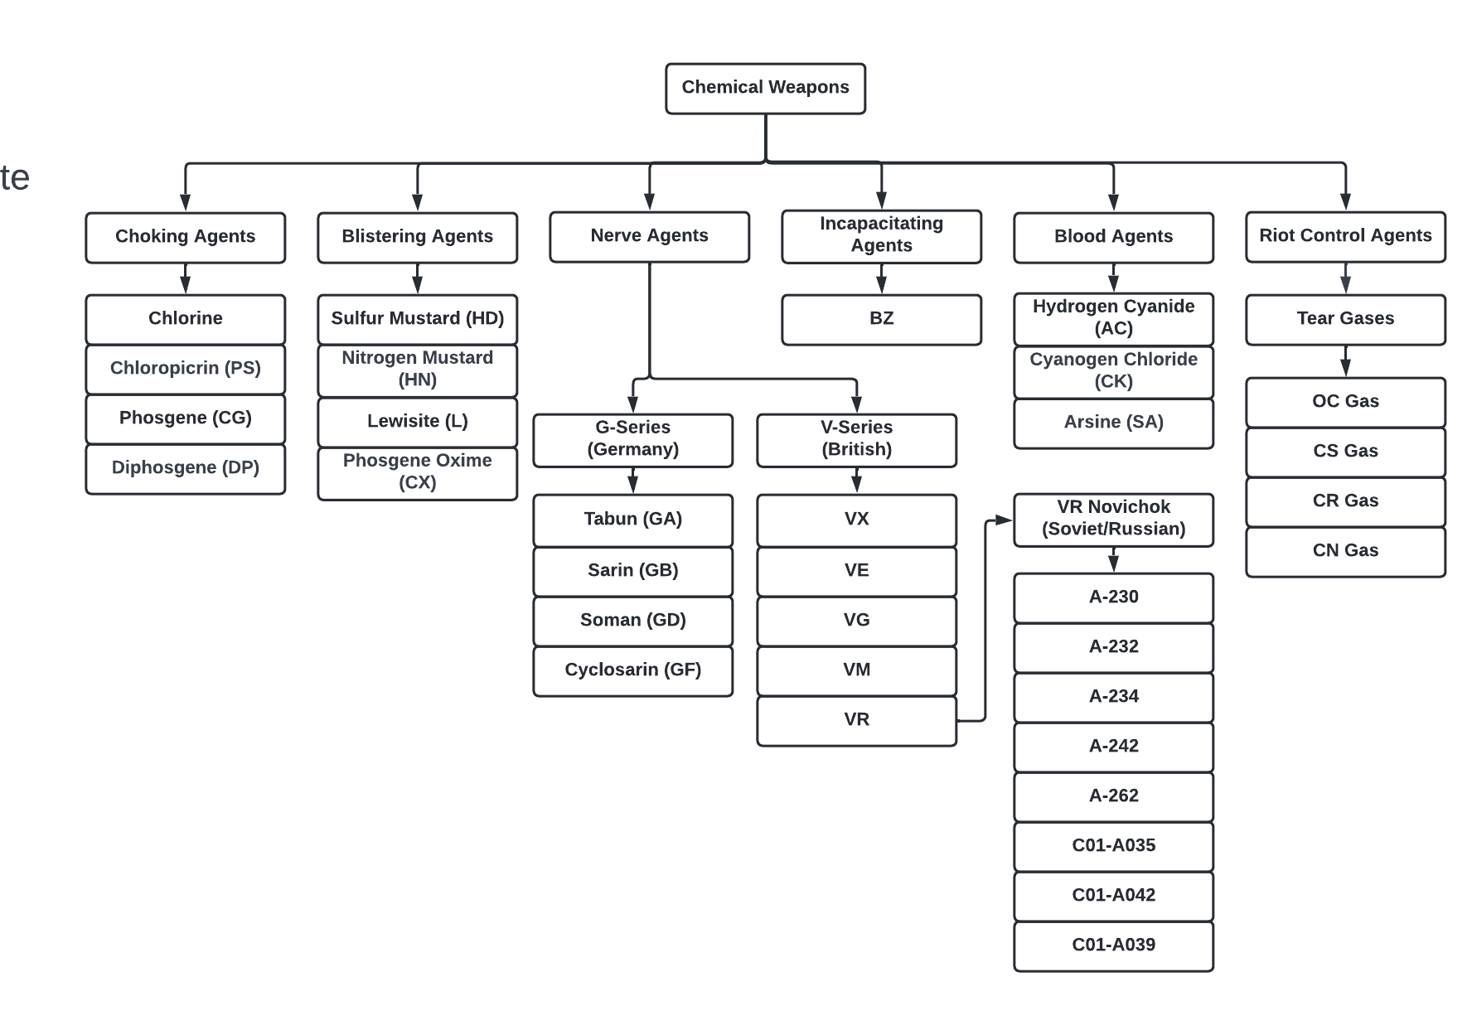

Slide 5
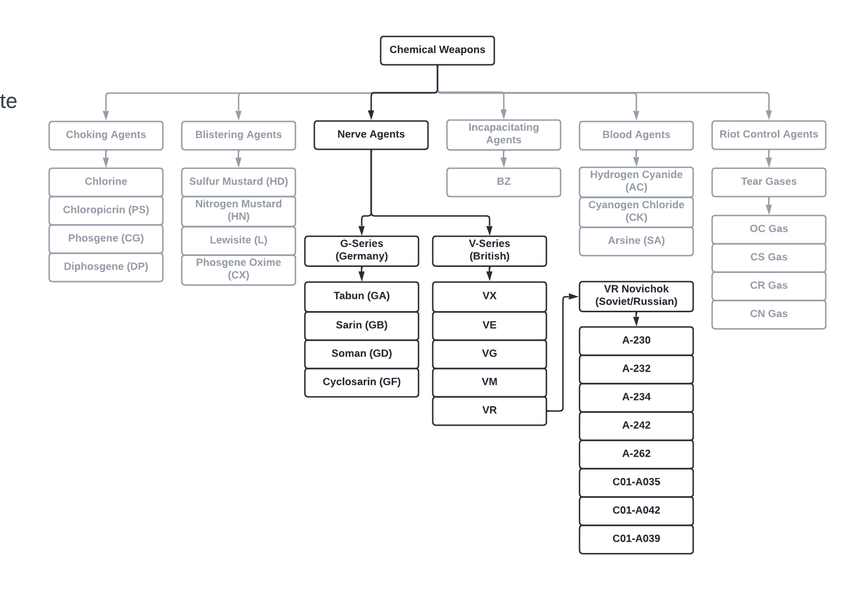
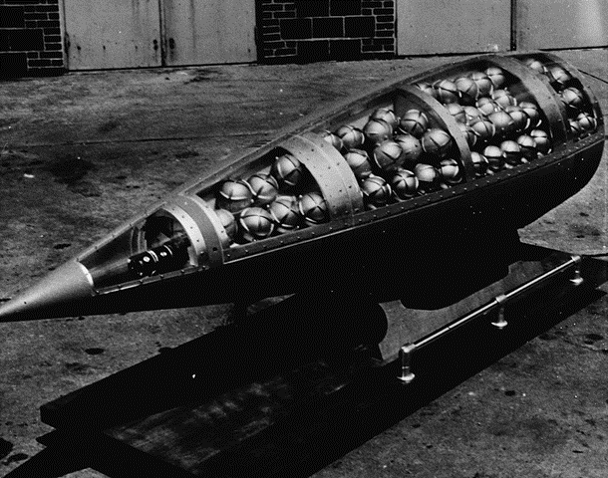
US Honest John missile warhead cutaway, showing M134 Sarin bomblets (c. 1960) Wikipedia.

Slide 6
Nerve Agents
Overview

Slide 7
Illustrative Case- Syrian Experience
“One doctor from Ein Tarma, who runs a small rural hospital for 20 patients, told me with a trembling voice that he received about 700 patients in just a few hours. In spite of the heroic efforts by him and his volunteer medical team throughout the night, 141 of his patients died, including 66 children. Another doctor told me that many arrived with respiratory failure- suffocating slowly, foaming and convulsing. He could save only few by placing them on life support, with limited access to respirators. He chose to save the youngest, as they had longer lives to live… Doctors [in Ghouta, Syria] had been able to get antidotes and equipment but not enough protective gear, which was reserved for the military. Many doctors and nurses had symptoms of exposure after a few hours of contact with their patients…
Notes:
The key point here is the sudden scale, mass casualty situation with limited resources and ignoring personal safety kills HCWs

Slide 8
Illustrative Case- Syrian Experience
“Dr. Abdel Rahman, from East Ghouta, treated scores of patients, protecting himself only with a simple face mask. He then developed blurry vision, tightness in his chest, and a severe headache. His eyes began tearing and his breathing became heavier. When he told his colleagues he was unable to continue working and that he needed help, they injected him with atropine and rushed to intubate him. He did not make it, joining the long list of Syrian doctors and nurses who have died or been killed on duty.”
-Dr. MZ Sahloul, 2016
Notes:
The salient points of the case:
1. mass casualty event that overwhelms resources
2. unknown agent- clearly a nerve agent, but unclear which one (likely soman)
3. healthcare workers are at high risk due to the amount of patients they will manage, the cumulative dose can be severe

Slide 9
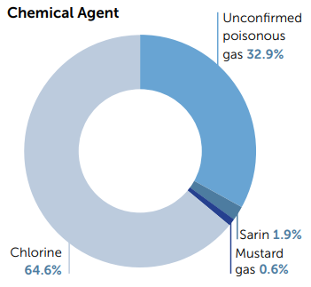
Syrian Experience
Syrian Chemical Weapons Attacks
161 Chemical Attacks (2012-2015)
14,581 Victims
1,491 Deaths
10.2% Mortality Rate
21-August-2013: Rural Damascus
A single sarin attack kills 1,300 and injures over 10,000.
Notes:
Sams 2016.

Slide 10
Nerve Agents- Outline
Pathophysiology
Exposure Types
Nerve Agent Basic Characteristics
Clinical Characteristics and Medical Management
Health Systems Preparedness
References
ALL SLIDES AND CHARTS WILL BE PERMANENTLY ARCHIVED AND ACCESSIBLE THROUGH A DEDICATED QR CODE AT THE END OF THE PRESENTATION
Notes:
This presentation provides a brief overview of nerve agents before focusing on hospital management of nerve agent victims.
I will use frequent case examples and photos to increase familiarity with the content of this topic.

Slide 11
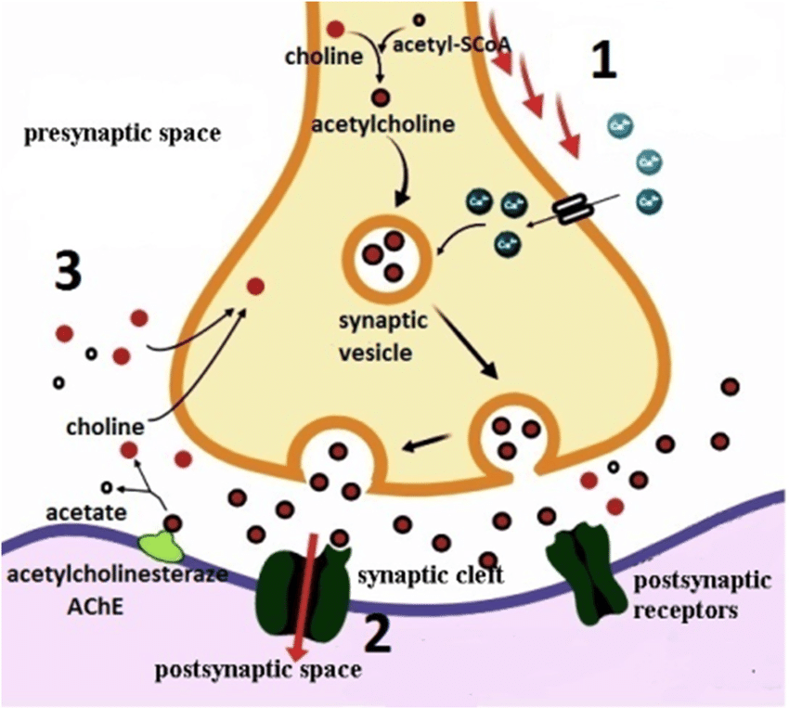
Pathophysiology: Mechanism
Organophosphates
Inhibit cholinesterase enzyme →
  Leads to buildup and persistent activity of acetylcholine on target organs

Slide 12
Pathophysiology: Aging
Aging is the time required for an agent-enzyme complex to become irreversible
Before aging has completed, the agent can be reversed/enzyme reactivated
Reversal can be achieved with Oximes, such as Pralidoxime, if administered before aging of the agent-enzyme complex has completed.
Some nerve agents have long, delayed aging times such as VX (48 hours).
Other nerve agents have nearly immediate aging times such as Soman (2 min).

Slide 13
Exposure Types
Vapor Exposures
Droplet/Liquid
Powder
In general, nerve agents are:
  Designed to attack via inhalation of vapors
  As evaporative as water (not like gasoline as is frequently assumed
  Slightly less able to penetrate skin.
Sarin
Soman
Tabun
Volatility
VX
Environmental Persistence
However, if droplets/liquid are trapped underneath clothing, thus preventing effective evaporation,
they will readily absorb through skin.
Eg: liquid sarin is more likely to evaporate off of skin than absorb through it.

Slide 14
Exposure Types- Vapor
Small / Dilute Vapor Exposures without Inhalation
  Small amount of vapor exposure cause direct, local effects on exposed tissues
  Local effects do not necessarily indicate systemic absorption.
  Example: brief exposure of eyes and nose without inhalation results in local miosis, rhinorrhea, salivation but not in systemic effects such as abdominal pain or diarrhea or bradycardia.
Sarin
Soman
Tabun
Volatility
VX
Environmental Persistence

Slide 15
Exposure Types- Vapor
Larger Vapor Exposures without Inhalation
  Larger vapors to exposed skin have much lower lethality as vapors do not as readily absorb through skin.
  Vapor exposure as cause a direct, local effect on exposed tissues, particularly on exposed mucosal membranes.
  Much less local effect on exposed skin tissue.
  High concentrations trapped underneath clothing may produce local topical effects but do not result in significant systemic absorption.
Sarin
Soman
Tabun
Volatility
VX
Environmental Persistence
Vapor has very little absorption from the air through the skin. If wearing a mask, as long as you don’t touch the liquid you will be relatively safe.

Slide 16
Exposure Types- Vapor
Small / Dilute Vapor Exposures
with Limited Inhalation
  Likely to produce effects of eyes, nose, and airway secretions
  Possibly progress to headache, nausea or abdominal pain
  Any more advanced symptoms suggest more extensive inhalation or exposure and warrant prompt evaluation and treatment.
Sarin
Soman
Tabun
Volatility
VX
Environmental Persistence

Slide 17
Exposure Types- Vapor
Small / Dilute Vapor Exposures
with Large Inhalation
  Onset of symptoms are immediate, not delayed
  Seconds: likely to produce effects of eyes, nose, and airway secretions
  2 minutes: progression to rapid cascade of loss of consciousness, and convulsions
  10 minutes: respiratory arrest,
  flaccid paralysis, and death
Sarin
Soman
Tabun
Volatility
VX
Environmental Persistence

Slide 18
Exposure Types- Liquid
Liquid-Droplet
  Onset of symptoms may be delayed
    Some cases of asymptomatic period of
    15-20 minutes despite large exposures
    Delay may be up to 18 hours
  Effects are dose-time dependent
  Onset may then be sudden and maximal
Sarin
Soman
Tabun
Volatility
VX
Environmental Persistence

Slide 19
Exposure Types- Liquid
Liquid-Droplet onto Exposed Skin
Small Exposure ( <1/10th drop 25% Soman)
  Local sweating, fasciculation
  Nausea, vomiting, abdominal pain, oral secretions, chest tightness
  Moderately Severe Exposure ( ~1/2 drops 25% Soman)
  Feeling of profound tiredness
  Generalized sweating, Copious oral and respiratory secretions
  Audible wheezing and respiratory congestion
  Severe Exposure (1 drop 25% Soman)
  Sudden Collapse and Loss of Conciousness
  Gasping, cyanosis, Diarrhea
  Convulsions and generalized myoclonic spasms
  Flaccid paralysis
  Respiratory arrest
  Cardiac Arrhythmias (all types)
Sarin
Soman
Tabun
Volatility
VX
Environmental Persistence

Slide 20
Illustrative Case- One drop of Soman
PMID: 4838227
  33 Year old healthy male exposed to a few drops of 25% Soman onto the face. Immediately washed face with chemical eye wash water station and taken to emergency unit. He was asymptomatic for ~10 minutes before suddenly feeling “sense of doom” and collapsing into coma and becoming cyanotic with slightly labored breathing, rapidly developing miosis, copious oral and nasal secretions. Atropine 2mg IV administered immediately. HR-150 and BP 180/80 after atropine.
  His mouth became rigid with trismus, neck stiff with nuchal rigidity, developed prominent generalized myoclonic fasciculations with hyperactive reflexes. An additional 4mg IV and 8mg IM atropine administered within 15 minutes of collapse followed by 2000mg IV Pralidoxime (pralidoxime administered 25 minutes after exposure). His respirations stabilized with improvement in airway sounds and he was maintained on oxygen supplement by oxygen facemask- he could not be intubated due to trismus. Since his respirations and oxygenation were stabilized on oxygen facemask, a tracheostomy was not performed.

Slide 21
Illustrative Case- One drop of Soman
PMID: 4838227
  At T=30 minutes, he began to awaken, endorsing generalized abdominal pain, feeling of restlessness and nausea throughout the day and night. Abdominal pain progressed to vomiting at T=14 hours after the exposure for which he was given additional 4mg IV atropine. He then developed acute urinary retention and required urinary catheter placement.
  He remained with continuous abdominal pain, experiencing vomiting at T=20 hours, T=22 hours, and T=23 hours. At each episode of vomiting he was administered an additional dose of atropine 2mg IV.
  At T=24 hours, he developed atrial fibrillation with ventricular rate of 100 beats per minute. He spontaneously converted to sinus rhythm with normal rate at T=48 hours.

Slide 22
Illustrative Case- One drop of Soman
PMID: 4838227
  At T=36 hours, he continued to have persistent nausea and vomiting. He also endorsed diffuse sensation of “tingling”, but no physical exam findings were noted.
  To this point, he had very poor ability to sleep. By T=48 hours, his physical condition began to improve more appreciably and he was able to sleep by the second night.
  Despite improving physical status, psychological manifestations began to appear by T=48 hours with appearance of depression, withdrawn and subdued affect, nightmares, restless sleep, and endorsed anti-social thoughts. He was treated with 5ug/kg Scopolamine IM injection and his mental status improved on mental performance tests. This effect was also achieved with oral scopolamine dosing. Time to discharge was not reported in the study.
  Despite improvements with scopolamine, he maintained reduced IQ scores and mental task performance scores for 6 months. Though an unexplained improvement in his mathematical IQ performance was detected at 6 months. His laboratory testing (CBC, BMP, PT/INR, LFTs) all remained normal.

Slide 23
Nerve Agent Basic Characteristics

Slide 24
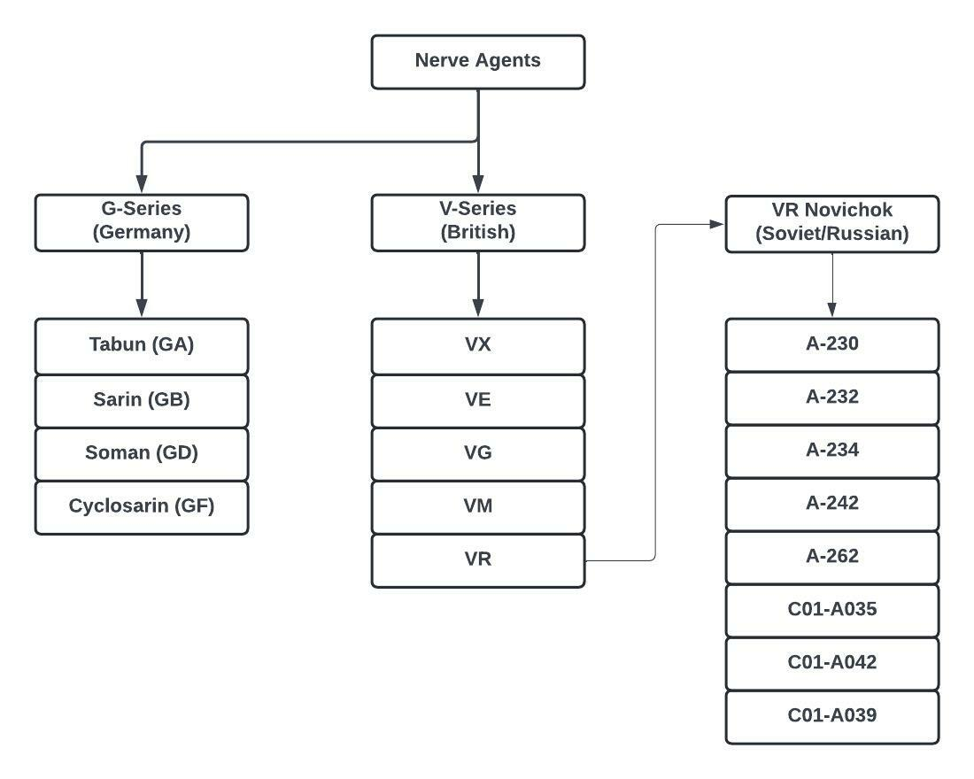

Slide 25
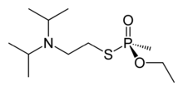
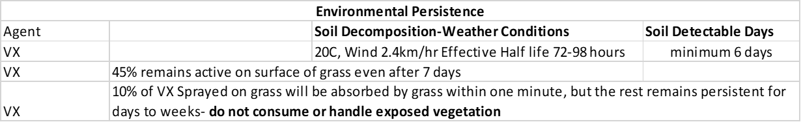
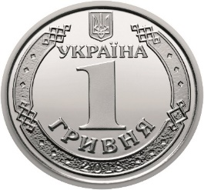
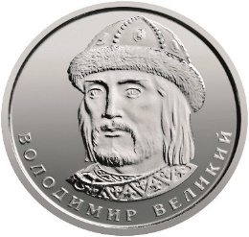
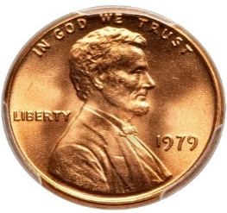
VX- “Venomous agent X”
Chemical name: S-{2-[Di(propan-2-yl)amino]ethyl} O-ethyl methylphosphonothioate
Characteristics: clear-to-amber color, odourless, tasteless
Aging time: 48hrs, thus Post Exposure Pralidoxime is effective even after symptom onset
Soil Persistence: 2-6 days
LD₅₀= 10mg VX

Slide 26
VX- “Venomous agent X”
Important Notes:
  The most deadly nerve agent
  Oily residue with mostly non-vaporous action (unless on hot surface)
    Persists in the Environment → Area Denial Weapon
LD₅₀= 10mg VX

Slide 27

Soman (GD)
Chemical name: 3,3-Dimethylbutan-2-yl methylphosphonofluoridate
Alternative agent: Chlorosoman (less toxic)
Characteristics: Technically Odorless, however some reports “ill-defined odor”, Fruity, or similar to Oil of Camphor
Aging time: ~ 2 minutes, thus Post-Exposure Pralixodime ineffective
Soil Persistence:

Slide 28
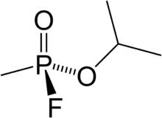
Sarin (GB)
Chemical name: isopropyl methylphosphonofluoridate
Alternative agent: Chlorosarin (less toxic)
Characteristics: Odorless, colorless, clear, tasteless
Aging time: 3hrs, thus Post Exposure Pralidoxime effective up to 6 hours
Soil Persistence:
Important Notes:
  Sarin is so volatile that it is more likely to evaporate off of the skin, rather than penetrate through the skin

Slide 29
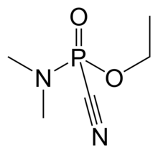
Tabun (GA)
Chemical name: Dimethylphosphoramidocyanidate
Characteristics: Faint fruity smell, colorless, clear, tasteless
Aging time: 13.3hrs
Soil persistence:
Important Notes:
  Evaporates 20x slower than water
  Vapor does not appear to decompose with sunlight/UV radiation
  "Field studies of ambient temperatures of soil found that 50% evaporated by 1.71hrs and 90% evaporated by 4.66hrs"

Slide 30

Cyclosarin (GF)
Chemical name: cyclohexyl methylphosphonofluoridate
Characteristics:
Aging time: 7.5hrs
Soil persistence:
Important Notes:

Slide 31
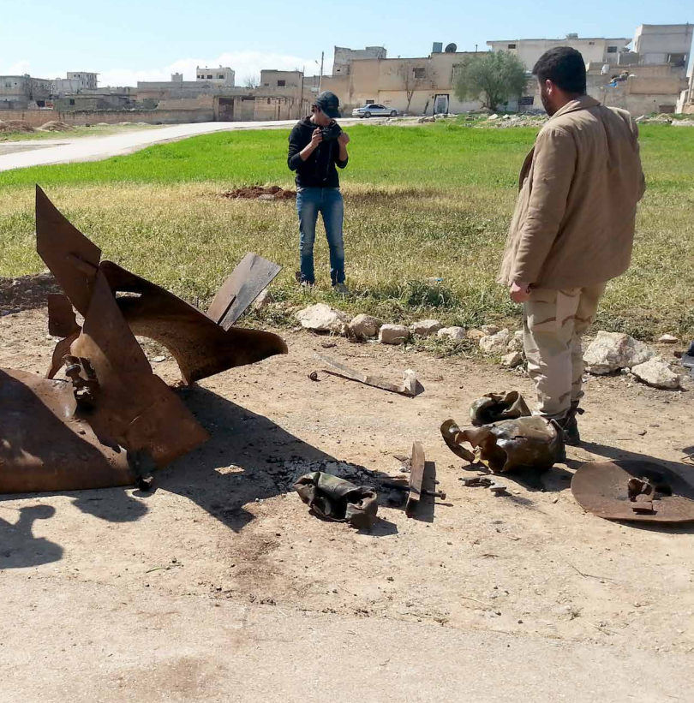
Image: SAMS, 2016
Notes:
Note the ring of dead grass around this unidentified chemical explosion in Sarmin, Syria 2015. The grass is not scorched, there is no crater.
Image source: A New Normal, Syrian American Medical Society, 2016.

Slide 32
Nerve Agents
Clinical Characteristics

Slide 33
Nerve Agents and Autonomic Nervous System
Muscarinic Nerve Receptors
Nicotinic Nerve Receptors
Hyper activation of Glands
  Lacrimal (eyes)
  Nasal (rhinorrhea)
  Bronchial (respiratory secretions)
  Vagus Nerve (bradycardia)
  Gastrointestinal (diarrhea)
Smooth Muscles
  Bronchial Constriction
  Gastrontestinal Constriction
Skeletal Muscle Hyper Stimulation
  Fasciculations & Twitching
  Fatigue → Paralysis
Pupillary Muscle Constriction
Nerve-Nerve Junctions (eg: ganglia)
  Tachycardia
  Hypertension
  Seizures

Slide 34
Nerve Agents and Autonomic Nervous System
Muscarinic Nerve Receptors
Nicotinic Nerve Receptors
Hyper activation of Glands
  Lacrimal (eyes)
  Nasal (rhinorrhea)
  Bronchial (respiratory secretions)
  Vagus Nerve (bradycardia)
  Gastrointestinal (diarrhea)
Smooth Muscles
  Bronchial Constriction
  Gastrointestinal Constriction
Skeletal Muscle Hyper Stimulation
  Fasciculations & Twitching
  Fatigue → Paralysis
Pupillary Muscle Constriction
Nerve-Nerve Junctions (eg: ganglia)
  Tachycardia
  Hypertension
  Seizures
IRREVERSIBLE WITH ATROPINE
PARTIALLY reversible with Pralidoxime.
REVERSIBLE WITH ATROPINE

Slide 35
Clinical Characteristics: Labs
PMID: 11749011
PMID: 16962140
Leukocytosis (common)
Creatinine Kinase (common)
Hyperglycemia (common)
Ketonuria (common)
Hypophosphatemia (common)
Serum Triglycerides
Acute stress response from seizure resulting in reactive leukocytosis and CK elevation.
Hypophosphatemia presumed from over-activation of muscles.
Not reported: lactic acid levels (expected to be elevated).

Slide 36
Clinical Characteristics: Constitutional
First symptom may be syncope
Localized sweating (diaphoresis)
Fever (common)
  Due to atropine
  Not necessarily due to true acute bacterial infection
Psychiatric: sense of doom or unease

Slide 37
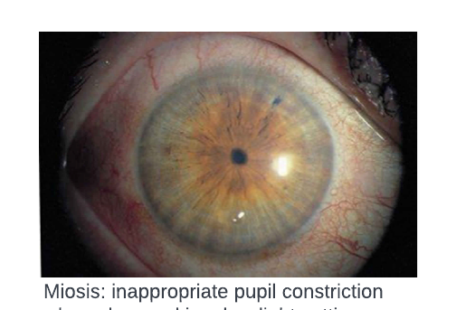
Clinical Characteristics: Eye
Miosis can occur from direct vapor exposure to the eye.
  Occurs within minutes
Small liquid exposure to skin in or near the eye will often cause miosis.
  Occurs within seconds
Small liquid exposure to skin elsewhere on body will not cause miosis.
Moderate liquid exposure to skin elsewhere on body may cause +/- miosis.
Large liquid exposure to skin elsewhere on body usually causes miosis.
Other Sx: eye pain, dim/blurry vision, conjunctival injection
  topical atropine drops as an adjunct to systemic atropine administration
  IV/IM Atropine does not significantly affect miosis recovery
  Only use topical atropine if severe eye pain- will cause blurry vision for ~24 hours

Slide 38
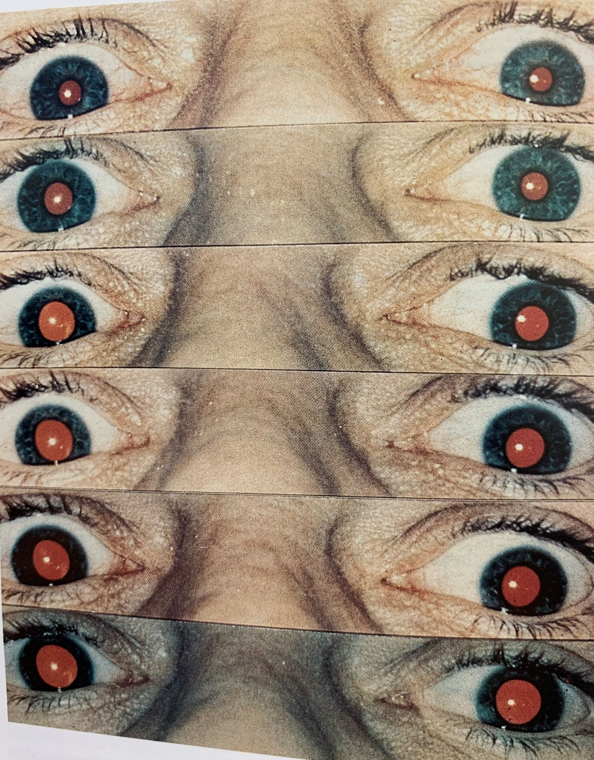
Clinical Characteristics: Eye
PMID: 4838227
Day 3
Case: accidental exposure to a small amount of Sarin.
Photos taken in total darkness by camera flash too fast for any pupil reaction.
The photos show the gradual ability of they eye to regain ability to dilate after the exposure.
Day 6
Day 13
Although miosis may respond slightly with atropine
During treatment for acute exposure,
Atropine treat to target is NOT based on eye exam
Day 20
Day 41
Subtext: Cellular recycle of damaged acetylcholinesterase enzymes begins within hours and may be completely replaced within a few days. As this image demonstrates, however, central nervous system damage may also have long term effects- 70% recovery by 2 weeks, 100% recovery by 2 months. As such, persistent miosis may require long term safety considerations for survivors such as avoiding night time driving or inside low light armored vehicles. Pupillary constriction is mediated by nicotinic receptors which do not significantly reverse with atropine
Day 62

Slide 39
Clinical Characteristics: Eye
PMID: 4838227
PMID: 12411624
Cornea contains a large amount of acetylcholine in the corneal epithelium.
ACh function in the corneal epithielium is primarily for cellular signaling more so than as a neurotransmitter.
  Involved in cellular homeostasis, pain recognition, cellular proliferation, ion transport and wound healing.
Light exposures of nerve agent to the cornea without systemic absorption may be associated with abdominal pain
  This pain is proposed to be a corneal reflex mediated by trigeminal-vagal nerve loop
  Has been called an “oculo-abdominal reflex”
Light exposures to cornea cause severe eye pain and associated with abdominal pain but without other signs of systemic exposure may be treated with topical atropine. But note: this will cause temporary, acute blurry vision from atropinization.

Slide 40
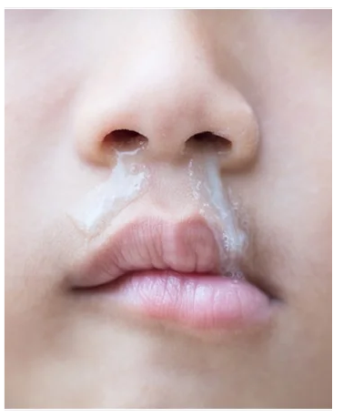
Clinical Characteristics: Naso-Pharynx
Small amount of vapor exposure to eyes, nose, and airways may cause rhinorrhea (runny nose), hyper-salivation (drooling).
This may be the result of local vapor contact with the tissues and does not necessarily indicate large systemic exposure.
Severity of rhinorrhea is often a dose dependent response.

Slide 41
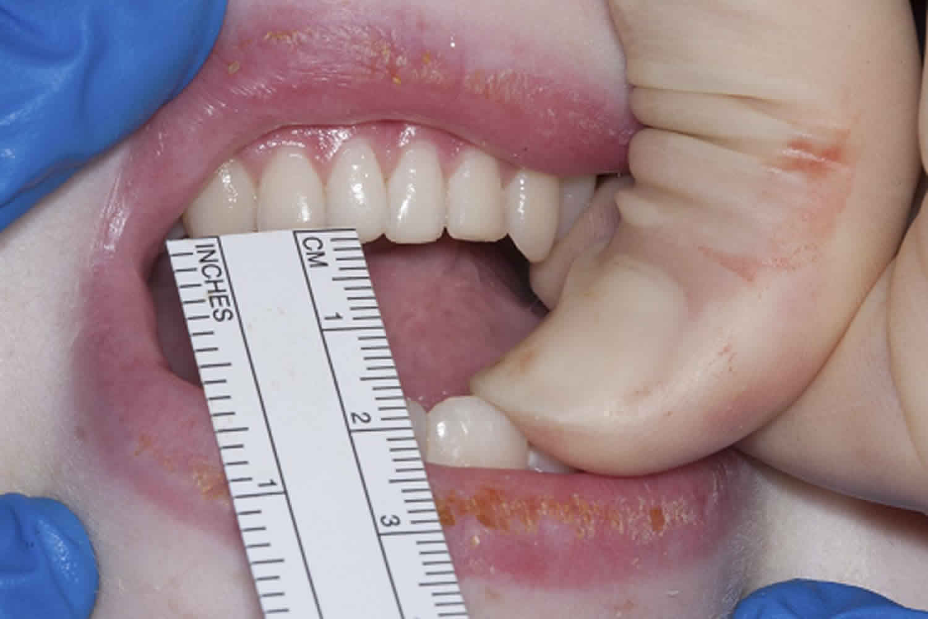
Clinical Characteristics: Naso-Pharynx
There are reports of difficult airway access due to Trismus
Trismus results from nicotinic activity and will not reverse with atropine
Treatment: Place a Oral Airway and Nasal Trumpet and bag-mask ventilate.
  (example on later slide)

Slide 42
Clinical Characteristics: Pulmonary
In a dose-dependent manner, vapors increase:
  Large increase in airway secretions
    Requiring frequent suctioning of airways
  Large increase in broncho-constriction = increased airway resistance
    Often high PEEP required to ventilate (sometimes as high as 50-70 cmH2O)
Large vapor exposure may causes respiratory arrest within seconds to minutes of symptom onset.
  Largely from central nervous system paralysis
  Partially from peripheral nerve weakness

Slide 43
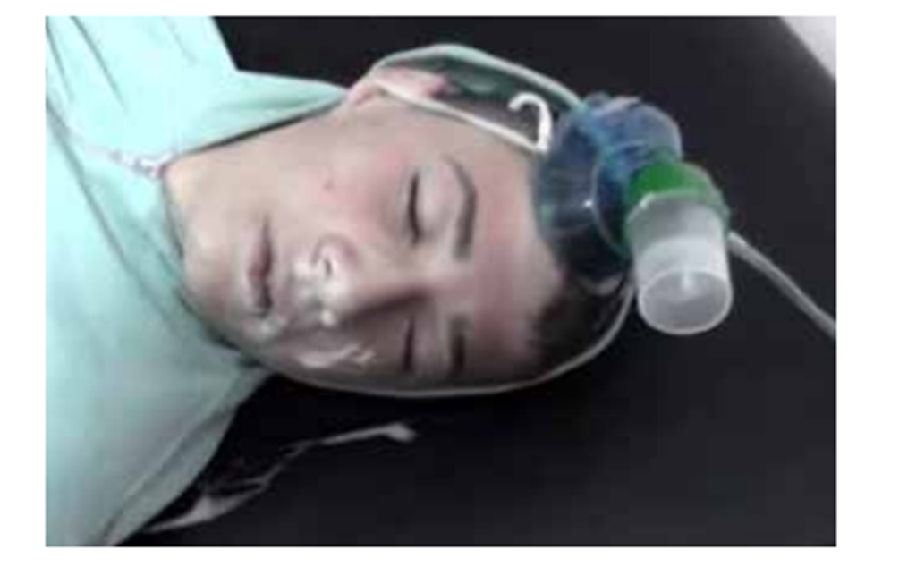
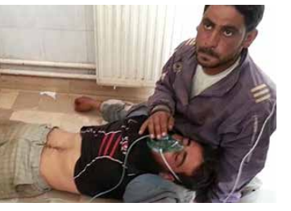
Image: SAMS, 2016
Notes:
Nerve Agent attack, Idlib, Syria, 2013.
Source: A New Normal, Syrian American Medical Society, 2016.

Slide 44

Clinical Characteristics: Pulmonary
Normal
Nerve Agent
Muscarinic agonism
  Severe Broncho-constriction
  Severe bronchial secretions
May require high PEEP to ventilate
  PEEP as high as 50-70 cmH2O
May require very frequent airway suctioning to clear secretions
Atropine is able to reverse the secretions and relax the broncho-constriction

Slide 45
Clinical Characteristics: Pulmonary- Small Exposure
Small Exposures may only cause sensation of chest tightness that will resolve within minutes of moving to fresh air.
  These effects begin to resolve within 15-30 minutes
At a chemical weapons research facility during the Cold War, exposed individuals would present to medical aid station ~20 minutes after exposure.
  Many would initially describe severe trouble breathing that was already resolving by the time of presentation 20 minutes later.
  In other cases, relief would not begin until treatments were administered.

Slide 46
Clinical Characteristics:Pulmonary-Large Exposure
Nerve Agent
Airway Management:
Early on, multiple doses Atropine 2mg q 3-5 minutes
Continue until secretions improve and able to ventilate with ease
May have to give a lot, US books say 20-30 mg
Syrian experience: up to 50mg in the first 24 hours
Atropine Treatment Target:
Atropine 2mg every 3-5 minutes until secretions improve and able to ventilate with ease

Slide 47
Clinical Characteristics:Pulmonary-Large Exposure
Duration of Ventilation
  Some reports of only a few hours
  Syrian experience: sometimes up to 3 days
Ventilation Modes:
  Assist Control/Volume Control (AC/VC or AC/VC+)
  Bilevel (BIPAP)
  Average Volume Assured Pressure Support (AVAPS)
  ✗ Pressure Support Only (PS)
  ✗ Synchronized Intermittent Mandatory Ventilation (SIMV)

Slide 48
Clinical Characteristics:Pulmonary-Large Exposure
PMID: 2394141
Time Course:
US Military Experience: mechanical ventilation for several hours
Syrian Experience: mechanical ventilation for several days (~3 days).
  Caution: this is unpublished data and represents consensus of clinical opinion, rarely were agents identifiable, though known Sarin, Soman, and Tabun known to have been used.
Taiwan Experience: mechanical ventilation for ~4.8-9.1 days
  Caution: data from agricultural poison exposure
  some cases averaged 11-19 days ventilation

Slide 49
Clinical Characteristics: Secondary Pneumonia?
PMID: 20663095
Does a secondary bacterial pneumonia occur with organophosphate poisoning?
Chest Radiographs: Diffuse Infiltrates and Pulmonary Edema
Leukocytosis: reactive after convulsions
Fever: atropinization
Syrian experience: incidence of secondary bacterial pneumonia is LOW
  Caution: this is unpublished data and represents consensus of clinical opinion.
Taiwan experience: with agricultural organophosphate poisoning, pneumonia is reported in higher rates (21.9%) but diagnostic criteria used have significant overlap with organophosphate poisoning syndrome as well as atropinization, potentially leading to over diagnosis of pneumonia.

Slide 50
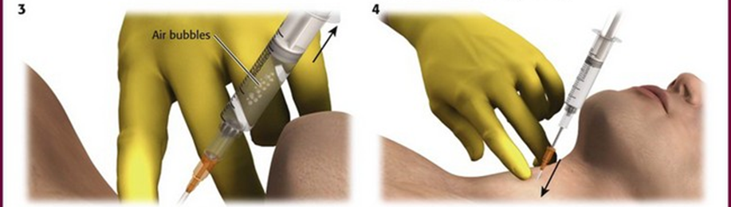
Clinical Characteristics:Pulmonary-Large Exposure
Nerve Agent
Additional broncho-constriction management options:
  Albuterol nebulization, (continuous, or every hour)
  Ipratropium nebulization, (every 6 hours)
  Tiotropium inhaler
  Magnesium sulfate 6 grams IV
    Short term effect, only if critical and failure of all other treatments
  Nebulized atropine
  Naso-tracheal tube administered atropine
  Percutaneous endotracheal administered atropine
Endotracheal Atropine:
4 to 6mg Atropine diluted in 5 to 10 milliliters
of 0.9% sodium chloride or sterile water
then injected into trachea
Notes:
Endotracheal Dose: 4-5mg Atropine diluted in 5 to 10 mL of 0.9% sodium chloride or sterile water and injected into trachea, effect uses pulmonary circulation to distribute systemically
It is unclear if theophylline would work- mechanistically it might but it has never been studied and thus cannot be recommended here.
There is no role for anti-inflammatory regimens such as steroids or cromolyn

Slide 51
Clinical Characteristics:Pulmonary-Large Exposure
Nerve Agent
Management notes on airway secretions
  Atropine may cause the secretions to thicken
  Thickened secretions may further impede ventilation
Additional treatment options:
  Frequent suctioning
  Turning patient every 2 hours
  Chest Percussive Therapy
  Nebulized sodium chloride (0.9%, 3%, 7%)
  Therapeutic bronchoscopy

Slide 52
Practical Aspects: Ventilation and Expired Vapors
In general, mouth to mouth resuscitation risks contamination to rescuer.
  Primarily in the form occult liquid agent still on the victim.
Expiration of contaminated breath is less risk, but not no risk.
  Of a quantity of inhaled sarin vapor, 10% is able to be exhaled in the first few breaths after the inhalation exposure. No data on later time periods of expired volatiles.
From: Sidell, p.158-159.

Slide 53
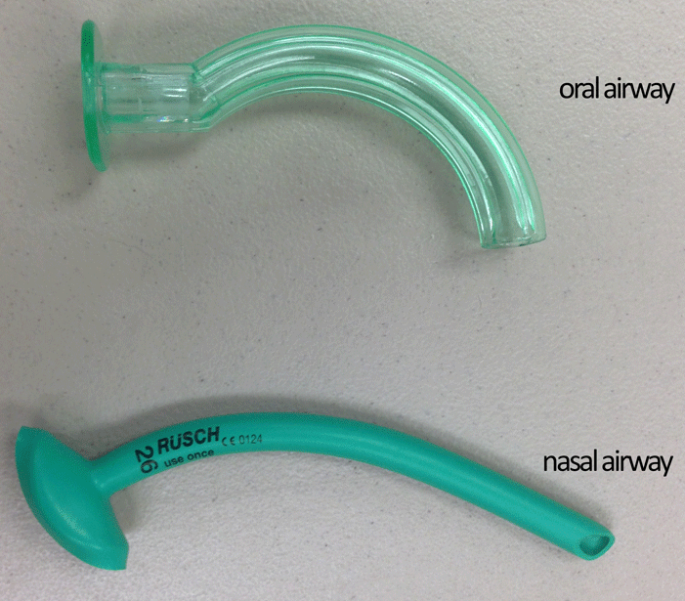
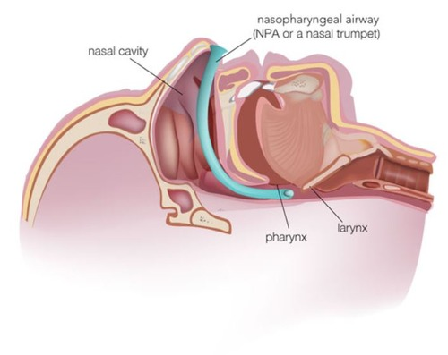
Practical Aspects: Airway with Trismus
Treatment: Place Oral Airway and Nasal Trumpet and bag-mask ventilate.

Slide 54
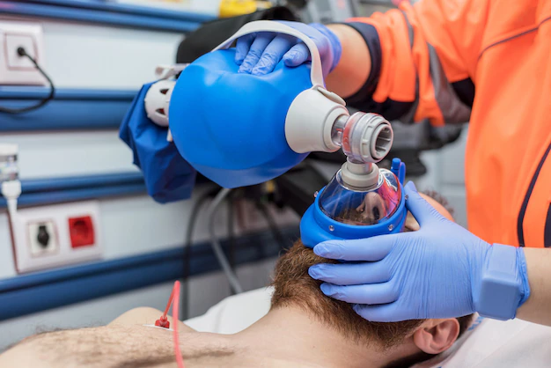
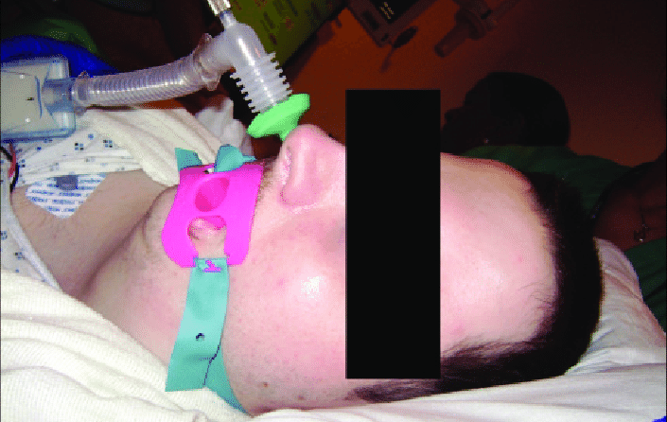
Practical Aspects: Airway with Trismus
Treatment: Place Oral Airway and Nasal Trumpet and bag-mask ventilate.

Slide 55
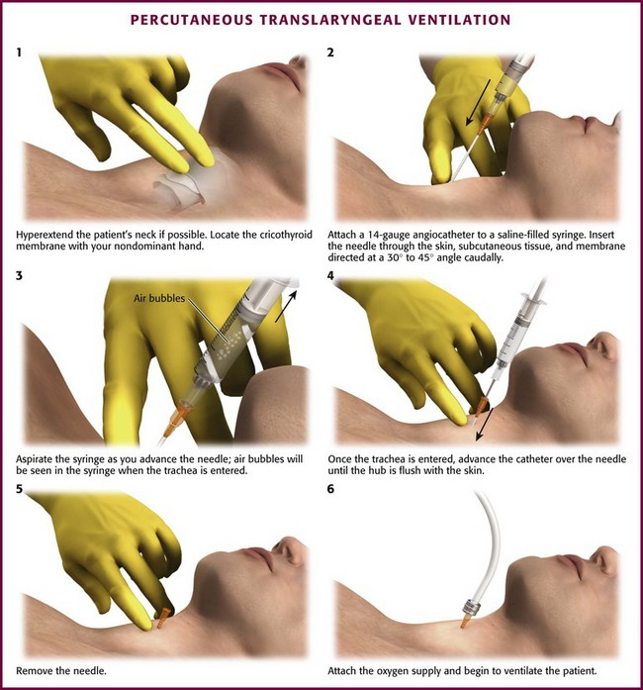
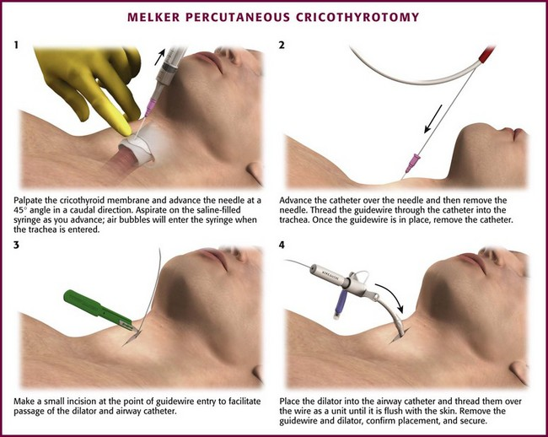
Rarely Indicated

Slide 56
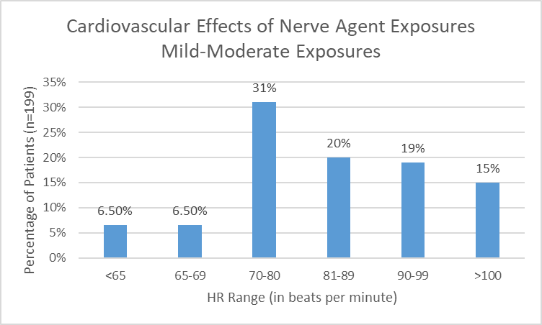
Clinical Characteristics: Cardiac
Bradycardia would be predicted but not actually that common
From: Sidell, p.156-157.

Slide 57
Clinical Characteristics: Cardiac
Reported arrhythmias include:
  Sinus Tachycardia
  Atrial Fibrillation
  Heart Blocks, various degrees
  ST segment depressions with T-wave flattening
  Ventricular Fibrillation*
    Early literature reports of Vfib with atropine before ventilation
Arrythmias subside early with initiation of atropine.
From: Sidell, p.165-166.

Slide 58
Illustrative Case- Cardiac
PMID: 4838227
A 52 year-old male suffered a large vapor exposure to sarin. He initially noted rhinorrhea and lacrimation and removed himself from the contaminated area. He presented to emergency medical area within 5 minutes of exposure and had already developed convulsions and cyanosis, labored breathing, muscle fasciculations, miosis, and continued marked salivation and lacrimation. Emergency administration of IM atropine 2mg followed by 2mg IV atropine with IV Pralidoxime 2000mg were initiated while oxygen by face mask was applied. An additional dose 2mg IV atropine was then administered- after that dose, his breathing became less labored and his cyanosis improved ~2-3 minutes. His HR was 130 and BP was 190/110mmHg. Marked fasciculations were still present but his bronchoconstriction and secretions were improved.

Slide 59
Illustrative Case- Cardiac
PMID: 4838227
20 minutes after initial presentation, another 2000mg Pralidoxime IV was administered. Copious oral secretions returned for which an additional 2mg IV atropine was administered. At 30 minutes after his presentation, he was now alert, but “intermittently irrational”. His physical exam at that time was notable for muscular fasciculations, bilateral pulmonary wheezes, S4 cardiac gallup, and marked miosis. He became nauseated and had small volume emesis.
Over the next 20 minutes, his respirations slowed. At 50 minutes he vomited again and became agitated and cyanosis returned- an additional 2mg IM atropine and an additional 2000mg IV Pralidoxime was administered. At 60 minutes, he became comatose and went into respiratory arrest for which supportive non-invasive ventilation was initiated while an additional dose of 3mg IV atropine was administered at a slower rate due to increasing pulmonary resistance.

Slide 60
Illustrative Case- Cardiac
PMID: 4838227
After 50 minutes of ventilation, weak spontaneous breaths were noted but he required ventilation until 135 minutes when when broncho-constriction again increased but improved rapidly after additional 2mg IV atropine was given.
At 150 minutes, he slowly began to have spontaneous respirations sufficient to maintain his own oxygenation. He continued to have episodes of nausea and emesis but had recovered well enough to stand and walk in his medical unit by 9 hours though he remained physical weak and areflexic.
Due to EKG changes (described on next slide), he was transferred for higher level of care.

Slide 61
Illustrative Case- Cardiac
PMID: 4838227
One hour after his exposure, an EKG showed sinus tachycardia with marked, diffuse ST segment depressions in all leads. His EKG at 18 hours showed ST segment elevations with T-wave inversions in V4-V6. A follow up EKG at 42 hours showed ST segment elevation in leads I, aVL, and V2-V6. None of these EKGs were associated with chest pain. His EKG patterns normalized over the next few days but T-wave inversions persisted for 4 weeks.

Slide 62
Illustrative Case- Cardiac
PMID: 4838227
His physical strength improved gradually but over the next 3 days he suffered from pronounced emotional lability. By day four, he remained weak but otherwise asymptomatic and after two weeks of bed rest was gradually introduced to physical therapy. By week 4, he was able to discharge.
After 4 months, he was hospitalized for dyspnea on exertion, progressive fatigue, restlessness, and vague chest and abdominal pains. Cardiac workup was negative. He was diagnosed with severe depression and anxiety about health. He was lost to follow up, but was found dead of acute myocardial infarction at ~18 months post exposure. [For additional post-mortem cardiac information, see source article by Sidell at PMID: 4838227]

Slide 63
Clinical Characteristics: Central Nervous System
1st: lost of consciousness
2nd: convulsions/seizures
3rd: flaccid paralysis (seizures likely continuing, but paralysis prevents myoclonus)
Medical literature endorses CANA/Benzodiazepine administration via the “buddy system”. This is because the first CNS symptom of nerve agent exposure may be loss of consciousness, preventing self administration of the anti-convulsant antidote.
Benzodiazepines (eg: diazepam, midazolam, lorazepam) are favored for treatment of seizures in nerve agent exposures. Seizures are thought to be more global and diffuse in nature, thus inhibitors of seizure progression such as phenytoin are NOT favored as abortive anti-epileptic drugs.

Slide 64
Nerve Agents and Autonomic Nervous System
Muscarinic Nerve Receptors
Nicotinic Nerve Receptors
Hyper activation of Glands
  Lacrimal (eyes)
  Nasal (rhinorrhea)
  Bronchial (respiratory secretions)
  Vagus Nerve (bradycardia)
  Gastrointestinal (diarrhea)
Smooth Muscles
  Bronchial Constriction
  Gastrointestinal Constriction
Skeletal Muscle Hyper Stimulation
  Fasciculations & Twitching
  Fatigue → Paralysis
Pupillary Muscle Constriction
Nerve-Nerve Junctions (eg: ganglia)
  Tachycardia
  Hypertension
  Seizures
IRREVERSIBLE WITH ATROPINE
PARTIALLY reversible with Pralidoxime.
REVERSIBLE WITH ATROPINE

Slide 65
Clinical Characteristics: Central Nervous System
In animal models, nerve agents (particularly soman) show evidence of disruption to the blood brain barrier
Medical literature endorses CANA/Benzodiazepine administration via the “buddy system”. This is because the first CNS symptom of nerve agent exposure may be loss of consciousness, preventing self administration of the anti-convulsant antidote.
Benzodiazepines (eg: diazepam, midazolam, lorazepam) are favored for treatment of seizures in nerve agent exposures. Seizures are thought to be more global and diffuse in nature, thus inhibitors of seizure progression such as phenytoin are NOT favored as abortive anti-epileptic drugs.

Slide 66
Clinical Characteristics: Musculoskeletal
Fasciculations are mediated via nicotinic receptors, thus do not improve with atropine.
After severe exposure, fasciculations may persist for hours even after regain of consciousness and improved strength.
Rhabdomyolysis may result from prolonged seizure.

Slide 67
Clinical Characteristics: Gastrointestinal
PMID: 4838227
In a dose-dependent manner, vapors increase.
Similar to oral and airway secretions
Do not use phenothiazines (eg: chlorpromazine, Compazine) for nausea which can make psychiatric symptoms in nerve agent exposure much worse.
Repeated episodes of nausea typically treated with additional atropine

Slide 68
Clinical Characteristics: Gastrointestinal
Special situation: light exposures of nerve agents to face
Light exposures of nerve agent to the cornea without systemic absorption may be associated with abdominal pain
  This pain is proposed to be a corneal reflex mediated by trigeminal-vagal nerve loop
  Has been called an “oculo-abdominal reflex”
Light exposures to cornea cause severe eye pain and associated with abdominal pain
but without other signs of systemic exposure
may be treated with topical atropine.
But note: this will cause temporary, acute blurry vision from atropinization.

Slide 69
Clinical Characteristics: Genitourinary
Nerve agents may cause loss of bladder control
However, atropine frequently associated with bladder outlet obstruction.
Genito-urinary management recommendations:
  Monitor urine output
  May check bladder for urinary retention
    Consider Point of Care Ultrasound for this
  May require urinary catheterization

Slide 70
Clinical Characteristics: Psychiatric
Acute exposure- agitation and irritability, combative, restlessness, tenseness
Early Post Acute- emotional lability, depression
Delayed- Depression and anxiety, personality changes
Mildly impaired cognition reported as a spectrum of symptoms such as slower response times and less attention to detail.

Slide 71
Long-Term Complications
covered in a separate presentation.

Slide 72
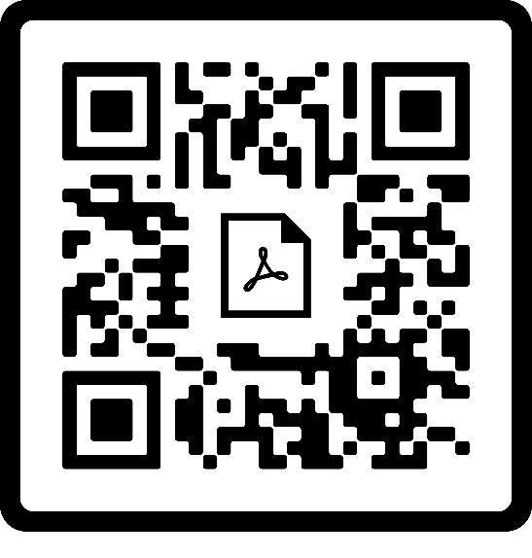
Treatments
Atropine, Pralidoxime, Pyridostigmine, Diazepam, Scopolamine

Slide 73
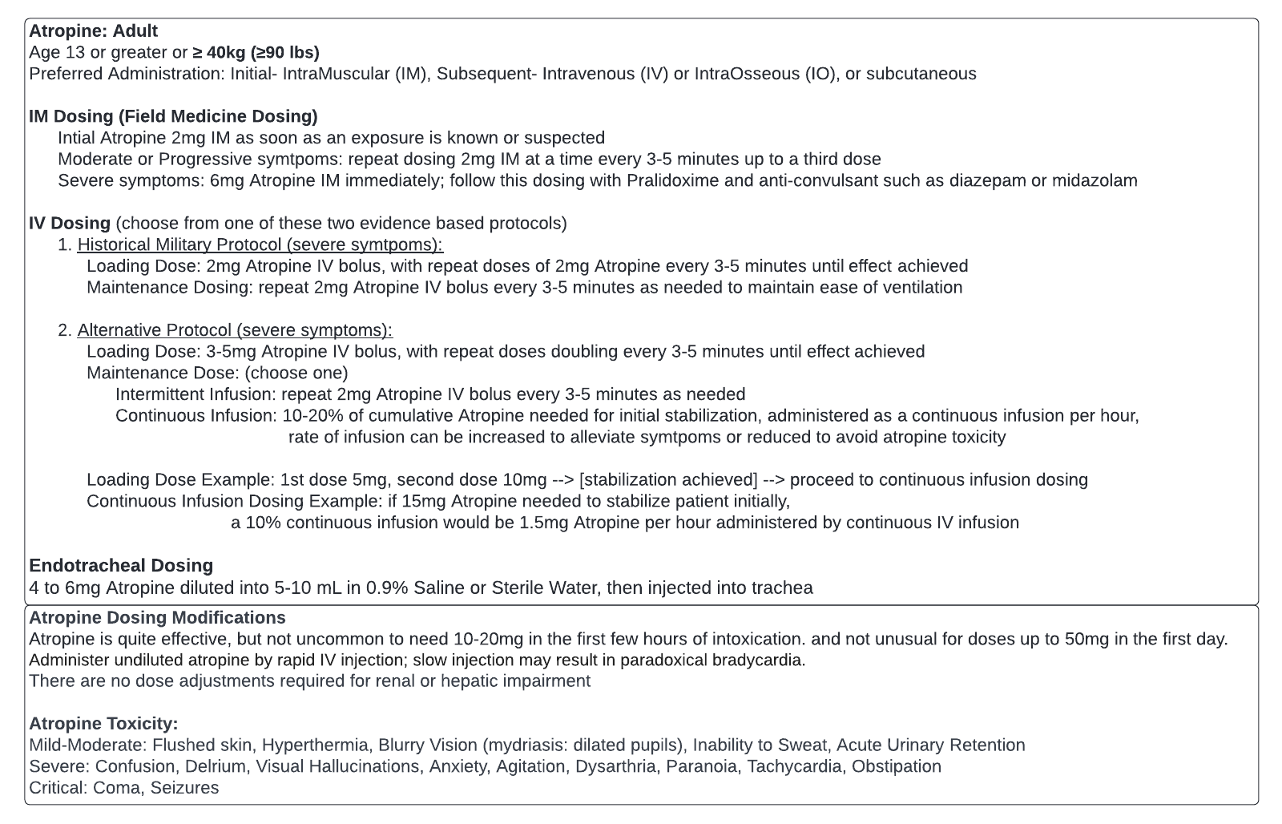
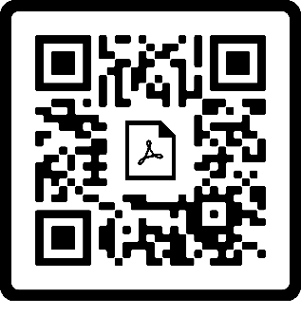

Slide 74
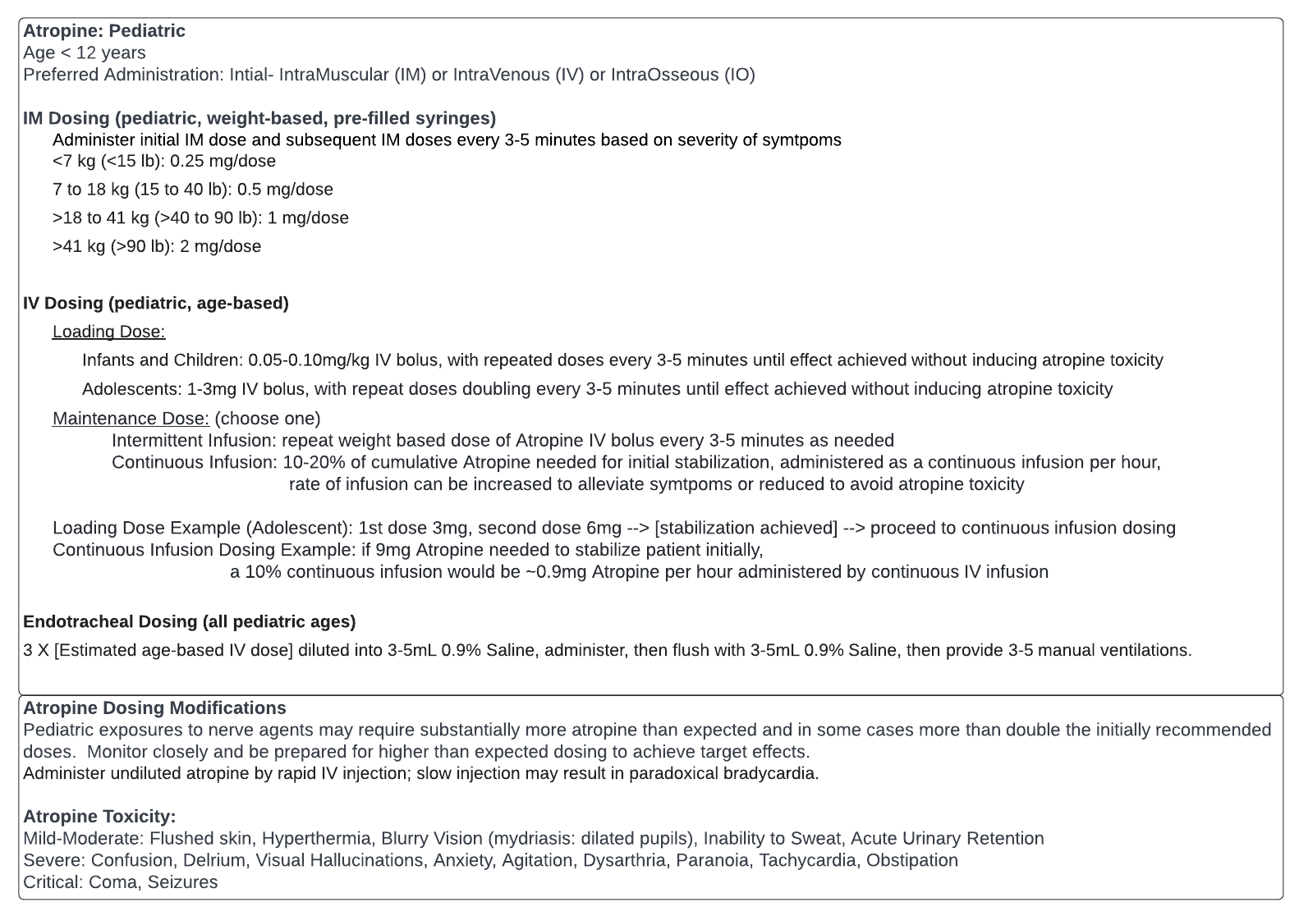
Notes:
PMID- 12949297

Slide 75
Atropine Toxicity
“Red as a beet”
“Dry as a bone”
“Hot as a hare”
“Blind as a bat”
“Mad as a hatter”
“Full as a flask”
Flushed skin
Anhidrosis
Anhidrotic hyperthermia
Nonreactive mydriasis
Delirium, hallucinations
Acute urinary retention

Slide 76
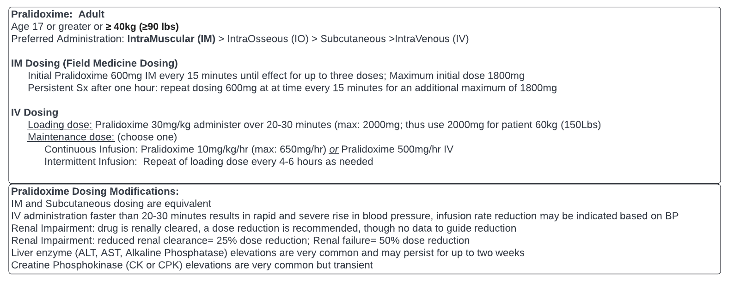
Notes:
When added to atropine therapy, 2-PAM reduces organophosphate mortality by an additional 30% in animal models. [PMID: 19931761]

Slide 77
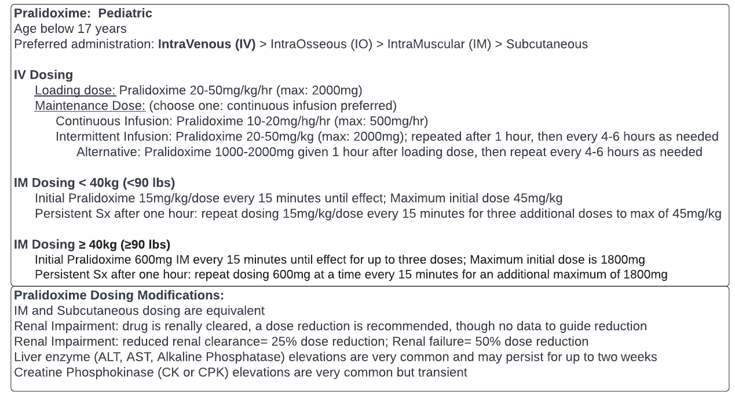

Slide 78
Benzodiazepines
If severe symptoms, including loss of consciousness or requiring up to 6mg Atropine, a benzodiazepine should also be administered due to significant risk of impending seizures.
Diazepam 10 mg IM Auto-Injector X 2-3 doses
Diazepam 0.3 mg/kg IV/IO, maximum 10 mg per dose
  Diazepam has relatively poor and variable IM absorption
Midazolam: 0.2 mg/kg (maximum 10 mg) IM
  Midazolam has relatively faster IM absorption than diazepam
Lorazepam: 0.1 mg/kg IV/IO/IM (maximum 4 mg)

Slide 79
Pyridostigmine (Mestinon®)
Acetylcholinesterase Inhibitor used in many neurologic conditions
Pre-treatment medication that reduces mortality against soman exposure.
Competitively occupies Ach-receptor, thus preventing soman binding
Saves ~30% of Ach-receptors from soman → enough to survive soman attack
Does not have mortality benefit as a pre-treatment for sarin or VX.
Not an Antidote: No effect as a post-exposure treatment for any agents.

Slide 80
Pyridostigmine (Mestinon®)
Pyridostigmine 30mg tablet every 8 hours
  While at risk for soman exposure
  Short duration: up to a few weeks at a time; not designed for long term use
  No dose reduction for renal impairment
Side Effects (expected cholinergic effects; all mild and temporary)
  Salivation, sweating, urinary incontinence
  Abdominal discomfort (7%)
  Loose stools (7%)
  Muscle twitches (3%)
  Muscle pains/Neck pain (2%)
  Amblyopia (2%)

Slide 81
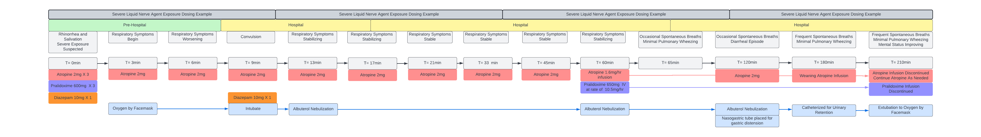
Illustrative Case- Dosing

Slide 82
Illustrative Case- Dosing

Slide 83
Illustrative Case- Dosing

Slide 84
Scopolamine (Off-Label Use)
PMID: 21121499
In animal models of nerve agent exposures, scopolamine has shown a synergistic effect with atropine.
When given early enough, it has been able to prevent seizures and improve mortality.
May reduce the overall amount of atropine required per patient:
Thus it may have a role in conserving atropine during acute hospital shortages
Notes:
Scopolamine is getting some interest, but it is not an FDA approved medication and cannot be formally recommended

Slide 85
Scopolamine (Off-Label Use)
It is not FDA-approved for treatment of organophosphates, and no human clinical trials exist, and optimal dosing is unknown.
Adult dosing: Scopolamine 1 mg IM/IV
Given as a single dose with initial dose of atropine
May also be given as an inhalation
Delirium possible with doses of 1.5mg or higher
Notes:
Scopolamine is getting some interest, but it is not an FDA approved medication and cannot be formally recommended

Slide 86
Scopolamine (Off-Label Use)
It is not FDA-approved for treatment of organophosphates, and no human clinical trials exist, and optimal dosing is unknown.
Pediatric dosing:
6 months- 3 yr: Scopolamine 0.15 mg IM/IV
3years- 6 yr: Scopolamine 0.3 mg IM/IV
>6 years- puberty: Scopolamine 0.6 mg IM/IV
Given as a single dose with initial dose of atropine
May also be given as an inhalation
Notes:
Scopolamine is getting some interest, but it is not an FDA approved medication and cannot be formally recommended

Slide 87
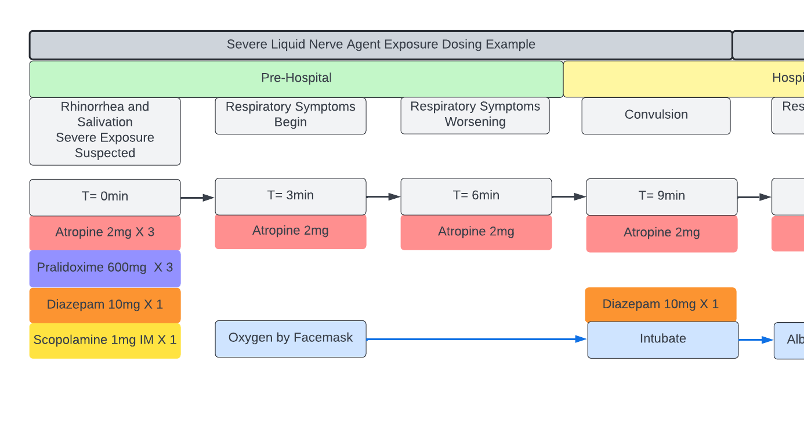
Scopolamine (Off-Label Use)
Notes:
Depending on local contexts and provider experience, an initial antidote regimen may look like this…

Slide 88
Hospital Systems Preparedness

Slide 89
Hospital Systems Preparedness
As the concern for CBRNE rises, pre-meditation of action plans helps to limit the impact of acute stresses on the hospital system and reduce preventable mortality.
These are no-notice mass casualty events that can overwhelm even robust hospitals due to a sudden, large influx of patients who exhaust the same resource, namely respiratory support and atropine.
Experience has repeatedly shown benefit of a “whole community” response system over a government-centric response.

Slide 90
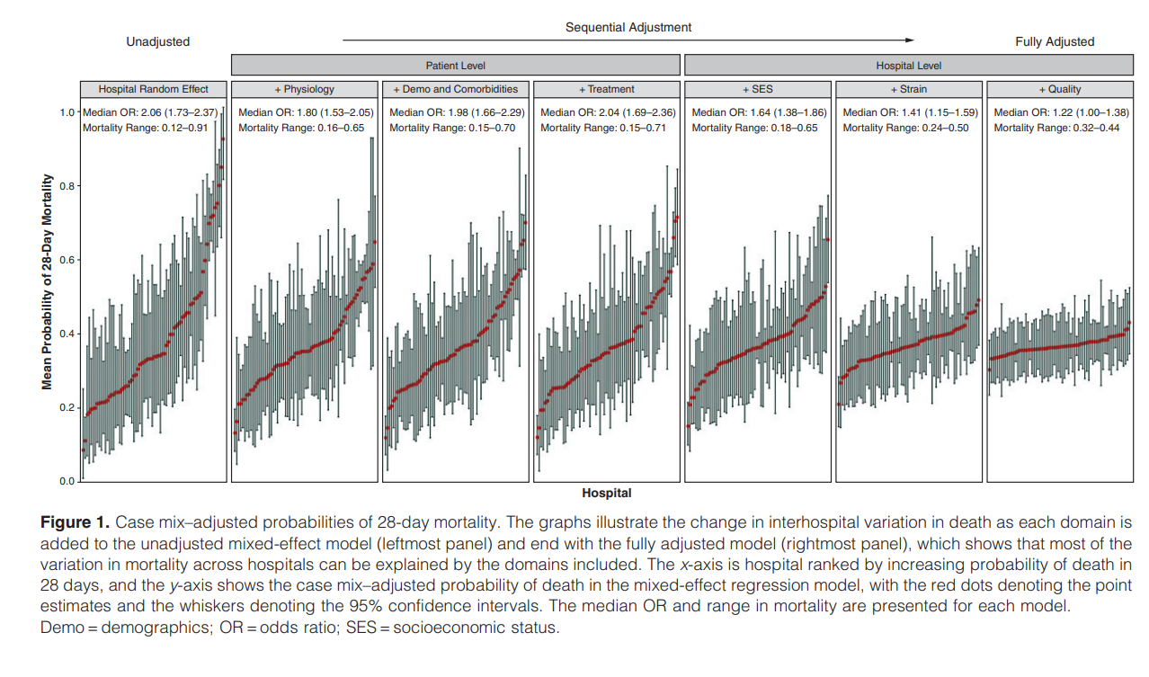
Variability in COVID-ARDS Outcomes
PMID: 33891529
Notes:
The importance of preparedness at the hospital system level cannot be overstated. Take this example with Covid-19 for instance.
This is a graph that charts the variability of mortality in ARDS between 70 different hospitals in North America. What it shows in each panel is that mortality in ARDS varied greatly between different hospitals.
On the left side of each panel, the red dot represents a hospital with approximately 20% ARDS morality and it rises to the top right red dot with some hospitals having nearly 90% ARDS mortality. This study, which will be clearer on the next slide, then looked at all the different factors that contributed to that variability.

Slide 91
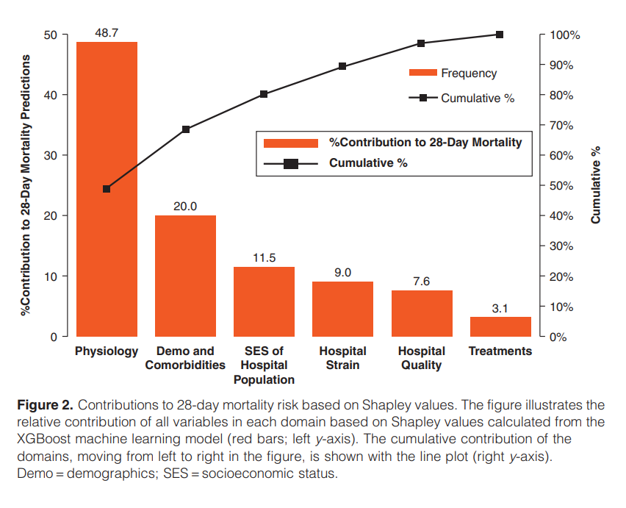
Variability in COVID-ARDS Outcomes
PMID: 33891529
48% of morality variation between these hospitals was actually due to physiologic differences in the patients
Only 3% of morality was attributed to differences in treatments

Slide 92
Variability in COVID-ARDS Outcomes
PMID: 33891529
48% of morality variation between these hospitals was actually due to physiologic differences in the patients
Only 3% of morality was attributed to differences in treatments
~10% of mortality attributable to hospital strain- this can be modifiable to some degree.
Notes:
However, nearly 10 percent of modifiable mortality can be attributed to mitigation of hospital strain. Now, much of this is not preventable and the majority of hospital recalibration of resources has already been done, but it does highlight the importance of keeping an eye open for opportunities to task shift and make staff work more efficiently.
The same emphasis on preparedness for chemical attacks may help reduce mortality attributable not to the nerve agent, but the excess mortality from sudden shock to the health system.

Slide 93
Hospital Systems Preparedness
Understand Incident Command Structure and Communication
Pre-registering a community wide medical reserve corps for MCI emergencies
Pre-assigned tasks and roles:
  1st Triage and Re-Triage
  Decontamination Team
  Intubation Teams, IV placement teams
  Pharmacy activation for atropine availability
Task shifting to offload staffing pressure points
  Suctioning and nebulization cannot be left on to a few respiratory therapists

Slide 94
Hospital Systems Preparedness
Healthcare asset protection against chemical attacks
Chemical attacks via vapors with higher density than surrounding air, thus vapors sink to basement and lower levels
  Clear out bottom floors of patients and critical supplies
  Patient movement plans
Gas-mask protocols in place
  Staff training for donning and doffing PPE gear
  Centralized location of gas masks and PPE

Slide 95
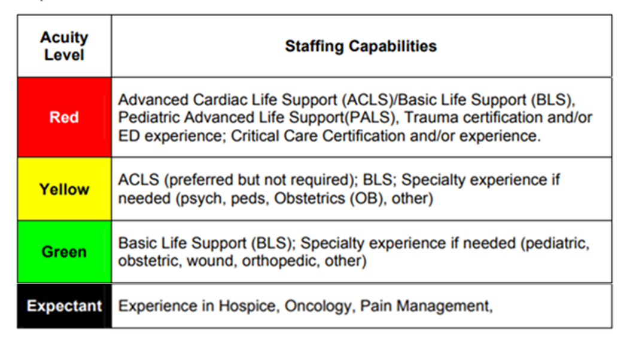
Hospital Systems Preparedness
Pre-defined planning of skill and assignments may save valuable minutes. One example of how to sort staff to their appropriate acuity level:
Medicine and ICU Physicians
Surgeons, Psychiatrists, Dentists, Physician Assistants, Outpatient Physicians
Hospital Nurses, Paramedic/EMTs
Notes:
It’s important to remember that these are mass casualty incidents that overwhelm healthcare capacity. In re-deploying healthcare staff to help manage the acute event, it is important to task shift to levels of care that are appropriate for the providers. Paramedics should not be running ICU code situations. For a counter-example, general practice providers with pulmonary experience should not be underutilized either on Expectant or Green/Minimal patient areas.
Examples of task shifting during an acute chemical attack: Dentists or Surgeons may be appropriate for Yellow/Delayed patient groups, outpatient nursing staff or paramedics may be appropriate for green/minimal patient areas or utilized in specific task oriented roles such as IV Access team.
These divisions should be PRE-planned amongst available or known staff rosters.
However, with many events, there will be healthcare workers that will suddenly appear. A decision should be made on if to use them, and then how to use them commensurate with their accredited skill level. For example, NGO physicians who show up to war zone.

Slide 96
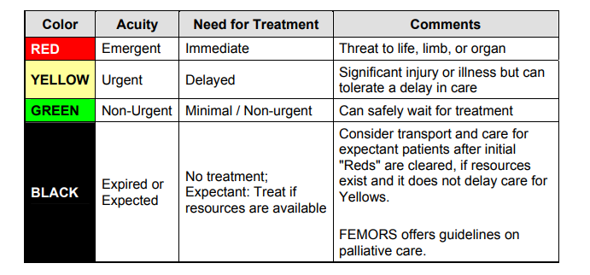
Hospital Systems Preparedness
Understand the triage system in place, the START method- Simple Triage and Rapid Treatment for example:

Slide 97
Hospital Systems Preparedness
Rapid screening of each person should last <1 minute:
  (R) Respiratory Status- Clear-Easy breathing, Gasping or Labored-Wheezing breathing, Apneic
  (P) Perfusion Status- Pulse, Weak Pulse, Cyanotic, or No Pulse
  (M) Mental Status- Alert, Comatose, Convulsing
The triage is done and only the simplest interventions administered here such as opening an airway or directing a bystander to apply pressure to a bleeding wound, or administer more atropine. The triaging provider then must move to the next person for triage while the care team initiates the appropriate interventions.

Slide 98
Hospital Systems Preparedness

Slide 99
Hospital Systems Preparedness
Understand the triage system in place, the START method- Simple Triage and Rapid Treatment for example:
Green/Non-Urgent: when people begin to show up to hospital en masse, having a director move lower acuity survivors to a staging area
  “If you can hear my voice and walk, come over here”.
  This can help to sort out the more acute or non-ambulatory survivors.
Any Liquid Exposure is automatically at a moderate risk and
should initially be considered Delayed/Yellow even if asymptomatic at time of presentation.

Slide 100
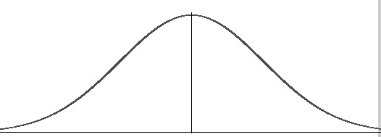
Hospital Systems Preparedness
Notes:
So what does a wave of patient’s look like?
If we charted out the illness of everyone on a bell-shaped curve.

Slide 101
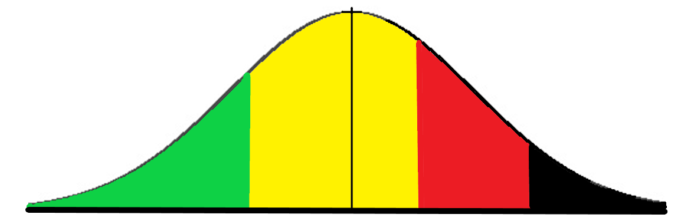
Hospital Systems Preparedness
Delayed
Immediate
Minimal
Expectant
Distribution of Severity in Mass Casualty Incident
(not drawn to scale)

Slide 102
Hospital Systems Preparedness
Delayed
Immediate
Minimal
Expectant
Distribution of Severity in Mass Casualty Incident
(not drawn to scale)
Notes:
Patients may remain dynamic in their classification, which is why re-triage and active surveillance is crucial to identify decompensating patients immediately, but also to move improving patients to lower acuity areas to free up high acuity staff. This is represented here by these arrows.
In the next few slides, we will discuss what might a representative patient look like in these different categories.

Slide 103
Hospital Systems Preparedness
Mass casualty incidents often follow a two-wave phenomenon, with a first wave of casualties arriving in the first hour.
  These are often a lower acuity wave
  (ie: they are able to walk away from the incident and present for evaluation sooner).
  They need to be triaged and cleared in preparation for the second, higher acuity wave.
Anticipate that 10-20% of victims will be pediatric
A general formula in mass casualty preparedness*
~Total Expected Casualties = 2 X [# casualties in 1st hour after first arrival]
Notes:
*this does not necessarily apply to chemical attacks, this is from literature on broader Mass Casualty Incidents.

Slide 104
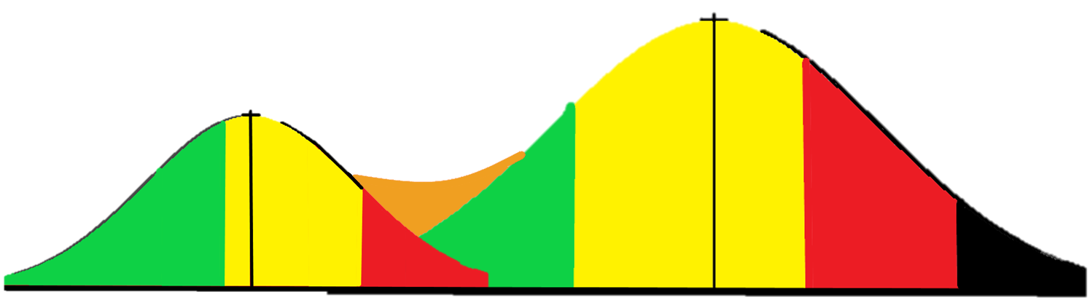
Hospital Systems Approach-
Two-Wave Phenomenon

Slide 105
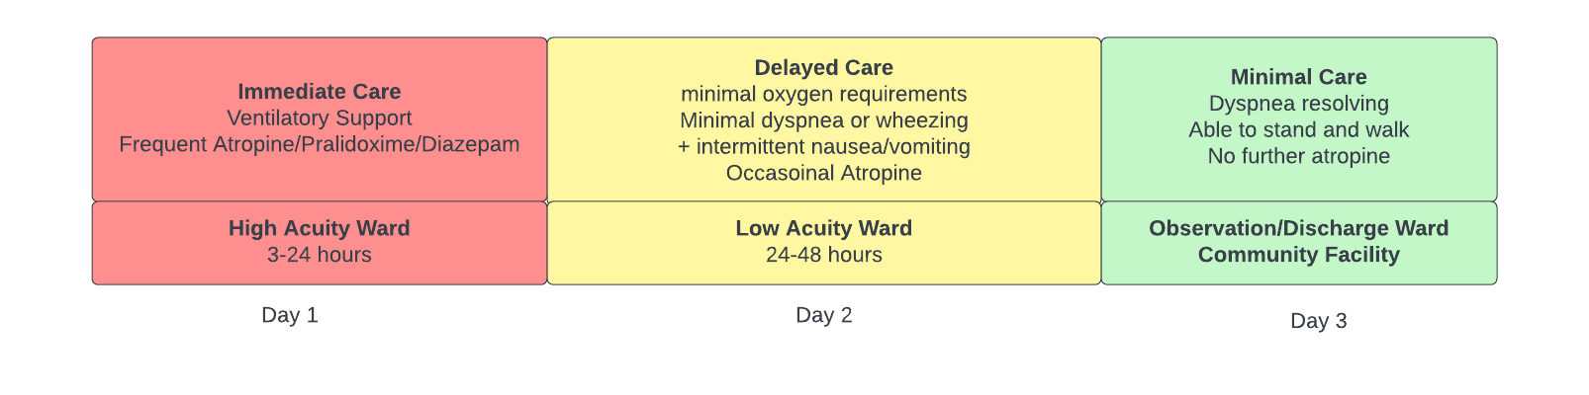
Hospital Systems Preparedness
Anticipated Hospital Course
Notes:
Hospital medicine physicians should anticipate short hospitalizations. The damage done by the nerve agents will have finished their manifestations and the patient can be further managed at a step down facility.

Slide 106
Hospital Systems Preparedness
Understanding of the anticipated clinical hospital course, with emphasis on safe but early discharges to intermediate locations (eg: other hospital wings, surrounding community centers)
Have a process for de-activating teams and restocking resources.
Experience has repeatedly shown benefit of a “whole community” response system over a government-centric response.

Slide 107
Hospital Systems Preparedness
Understand that many survivors will come who do not need hospitalization. An out-door or large observation area may be sufficient.
Other survivors may show up out of fear or with psychological trauma, be prepared to direct them to an appropriate location for psychological first aide.

Slide 108








Hospital Systems Preparedness-
Exposure Zones
Hot Zone- Contaminated
Warm Zone
Decontamination Zone
Cold Zone- Decontaminated
Notes:
It is important to understand where the healthcare facility fits into the continuum of care in a chemical casualty event.

Slide 109
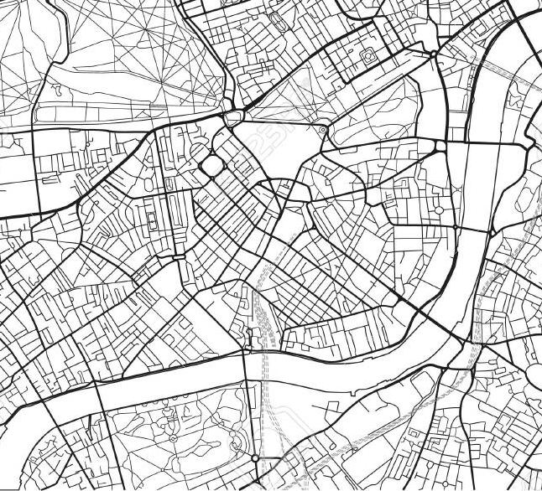






Hospital Systems Preparedness
Syrian Experience: “whole community” response system.
Notes:
The Syrian experience: chemical attacks and unpredictability of wind conditions lead systems on the ground to organize into L-shaped units. These would typically have a hospital-church-school pairing selected geographically. If an attack occurred near one facility, the other downwind facilities were already identified as rally points. Medical equipment was packaged and easily loaded into a vehicle that could move from one point to another, depending on where the medications and respiratory supplies were needed. Community coordinators with handheld radios would communicate and direct victims to the appropriate location and away from the hot-contaminated zone.
After the acute illness phase, the community centers were then staging areas for survivors to go for continued convalescence, if needed, to clear space in the treating facility for subsequent waves or new attacks.

Slide 110
Illustrative Case- Syrian Experience
“I was sleeping in the doctor’s house in one of the basements beside the operation room. At about 2:30am, we got a call from the central ER. The physicians who were on staff that night informed me that it was a chemical attack. I arrived and in the next 10 minutes, it was like a nightmare. One of the medics entered and said gas had fallen in Zamalka and all the people died. Then I realized that it was a huge chemical attack. All of the hospitals from Zamalka to Douma were filled. I asked some people to go to the mosque and use the speakers to request that everyone who had a car go to Zamalka and help. I don’t know if it was a wise decision or not. But there were so many heroes that night. Our local culture says that we would die to save others.

Slide 111
Illustrative Case- Syrian Experience
“The numbers became over all capacity. I asked to our staff to do medical work in two schools and mosques, where there are water tanks. If there is no water, you don’t have a hospital. There was just one person who could classify the patients— me. I was the only one who studied it. I had to decide quick response for bad cases and delay medium and moderate cases. After 30 minutes, there were hundreds. We didn’t realize how many, but we knew there were hundreds.
“I put two medics on the door of the ER. I said that every patient who is unconscious or shaking, take him down to the ER. All kids or seniors, or anyone shouting loudly, put him in the second ER. All others should go in the third medical point. We could not do anything in the second or third medical points—we could not provide them with any medicine. From the first hour, I gave all staff their mission so that they know what to do. I told them not to ask, just to give atropine to all.

Slide 112
Illustrative Case- Syrian Experience
“The first problem was washing the bodies. The second problem was just how many people were there. The power engine became unable to warm water. The other problem was that most patients were female and we were unable to give them any privacy. They were delivered in sleeping suits.
“After 90 minutes, one of my medical staff fell down. The symptoms began to appear on medical staff themselves, and we had to change our strategy. I chose to see the patients one by one, and check vital signs to see if there was a misunderstanding. I spent 5 seconds for every patient, and did not do any medical procedures myself—I just made decisions. The staff did a great job here.

Slide 113
Illustrative Case- Syrian Experience
“At 11 am, the bombs and shelling began. The regime used to use bombs after every chemical attack. We see dead bodies without blood as doctors. But when the media sees blood, they will be confused. I called my friend Majed and he was crying as we prepared the first report for media. The number in Douma was 630 patients and 65 victims. We could realize some symptoms we never saw before.

Slide 114
Illustrative Case- Syrian Experience
“I will never forget the work of the medical staff and civil defense members—how they pulled the people up and brought them to the medical points. When everything was okay, they checked houses. One told me a story of how when he entered the house, he found a man had arrived to the door and put his hand on handle to get out but couldn’t get out. He was holding his kids.
“Some people kept their birds in cages, and those were dead. Of course the free birds were okay. But humans cannot fly.”
-Dr. Khalil Al Asmar
Douma, East Ghouta, Syria
July, 2015
Notes:
SAMS 2016

Slide 115
Decontamination and Personal Protective Equipment
covered in a separate presentation.

Slide 116
Summary
Chemical weapons attacks are a renewed threat in modern warfare. Here, basic principles of organophosphorus based nerve agent physiology, exposure types, and medical treatment was reviewed. Illustrative cases were presented to give familiarity with key aspects of the medical management and the impact of no-notice mass casualty incidents as they relate to health system stress and the enduring threat of chemical exposures to healthcare workers outside of the contamination zone. Proactive health system preparedness measures may help to limit excess mortality caused by acute system stresses.

Slide 117
References
Churpek MM, Gupta S, Spicer AB, Parker WF, et al. Hospital-level variation in death for critically ill patients with COVID-19. Am J Respir Crit Care Med 2021; 204:403-411. [PMID: 33891529]
Florida Department of Health- Hospital medical surge planning for mass casualty incidents. Available at: https://www.urmc.rochester.edu/medialibraries/urmcmedia/flrtc/documents/wny-hospital-medical-surge-planning-for-mass-casualty-incidents.pdf [Accessed: 4/1/2022]
Galloway G, Wertheim M, Broadway D. Acute glaucoma with abdominal pain. J R Soc Med 2002; 95:555-6. [PMID: 12411624]
Koplovitz I, Schulz S. Perspectives on the use of scopolamine as an adjunct treatment to enhance survival following organophosphorus nerve agent poisoning. Mil Med 2010; 175:878-82. [PMID: 21121499]
Nerve Agents. In: Hurst G, Stich J, Byrne T, Lenhart MK et al. (eds.) Medical management of chemical casualties. 5th Ed. Ft. Sam Houston, TX: Borden Institute.
Nerve Agents. In: Sidell FR, Takafuji ET, Franz DR (eds.) Medical aspects of chemical and biological warfare. Washington DC: Office of the Surgeon General.
Okudera H. Clinical features on nerve gas terrorism in Matsumoto. J Clin Neurosci 2002; 9:17-21. [PMID: 11749011]

Slide 118
References
Rosman Y, Makarovsky I, Bentur Y, Shrot S, et al. Carbamate poisoning: treatment recommendations in the setting of a mass casualties event. Am J Emerg Med 2009; 27:1117-24. [PMID: 19931761]
Rotenberg JS, Newmark J. Nerve agent attacks on children: diagnosis and management. Pediatrics 2003; 112:648-58. [PMID: 12949297]
Sidell FR. Soman and sarin: clinical manifestations and treatment of accidental poisoning by organophosphates. Clin Toxicol 1974; 7:1-17. [PMID: 4838227]
Syrian American Medical Society, 2016. A new normal- ongoing chemical weapons attacks in Syria. Available at: https://www.sams-usa.net/wp-content/uploads/2016/09/A-New-Normal_Ongoing-Chemical-Weapons-Attacks-in-Syria.compressed.pdf [Accessed: 4/1/2022]
Tsao TC, Juang YC, Lan RS, Shieh WB, et al. Respiratory failure of acute organophosphate and carbamate poisoning. Chest 1990; 98:631-6. [PMID: 2394141]
Wang CY, Wu CL, Tsan YT, Hsu JY, et al. Early onset pneumonia in patients with cholinesterase inhibitor poisoning. Respirology 2010; 15:961-8. [PMID:20663095]
Yanagisawa N, Morita H, Nakajima T. Sarin experiences in Japan: acute toxicity and long-term effects. J Neurol Sci 2006; 249:76-85. [PMID: 16962140]

Slide 119
Слава Україні!

Slide 120
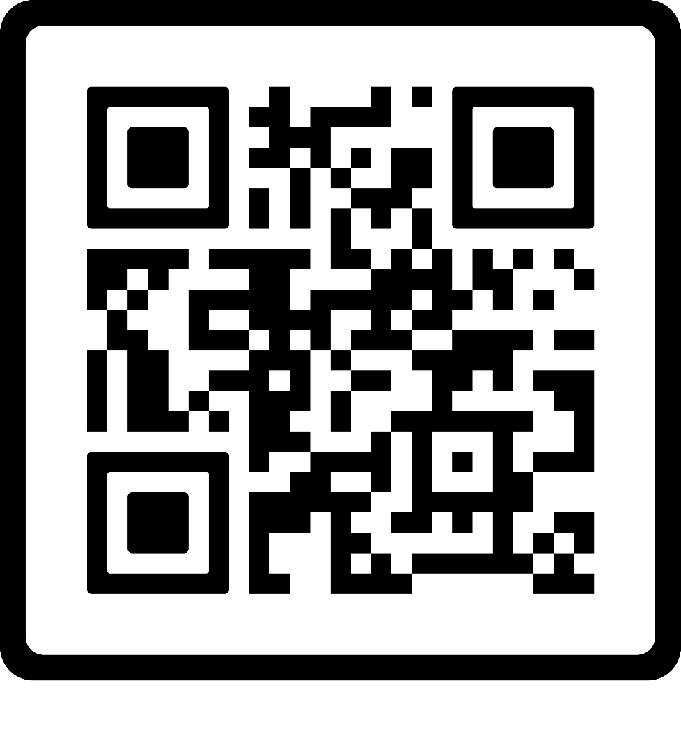

QR Codes
PDF of Treatment Slides Only
PDF of Full Presentation

Slide 121

Feedback Please!
A quick, free, and helpful way to support the creator.

